Slide 1
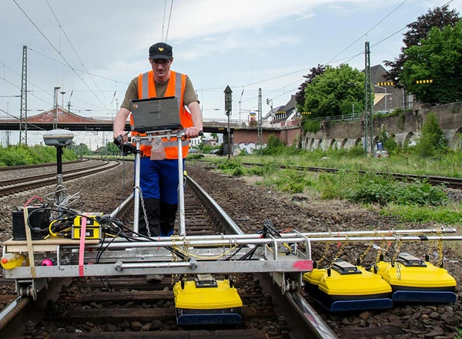
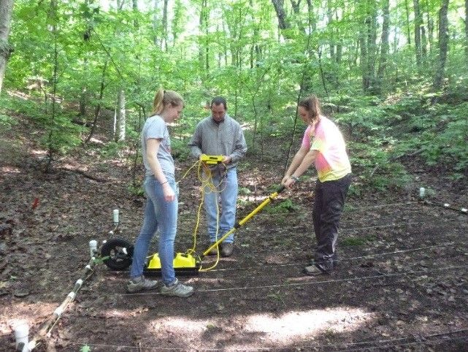
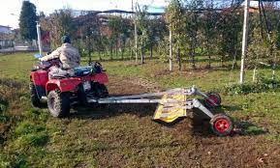
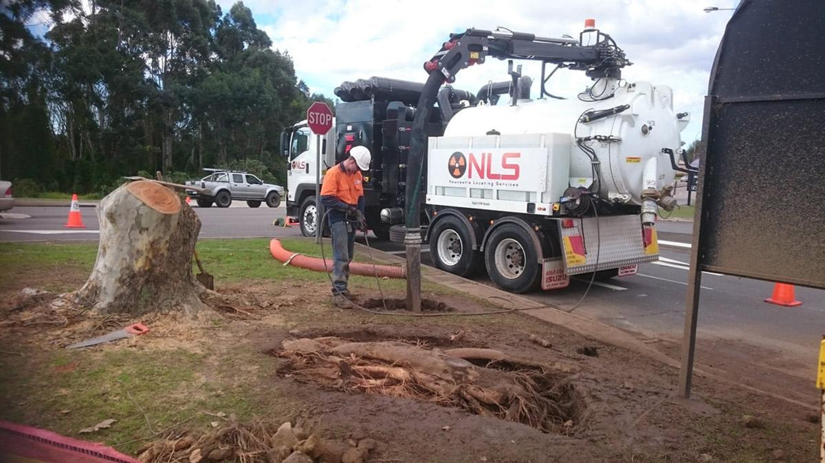
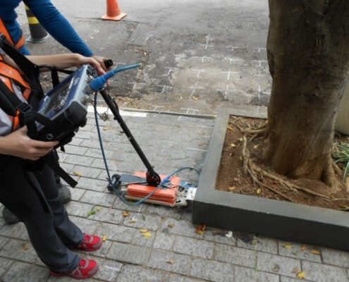
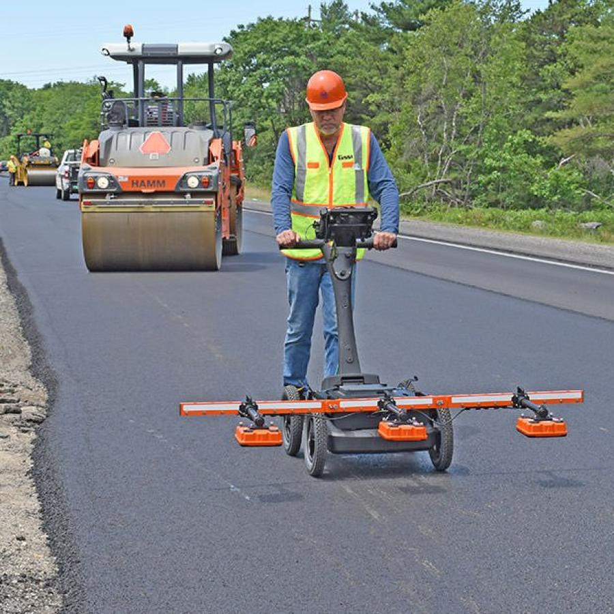
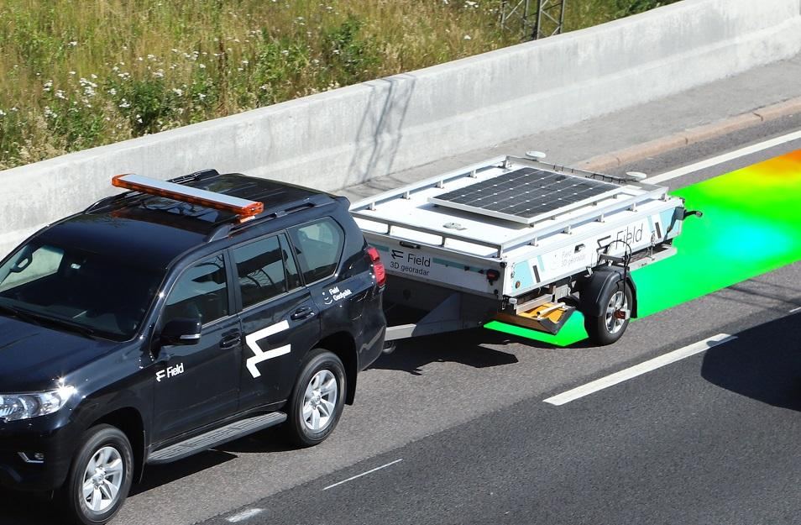
Ground Penetrating Radar
A brief explanation before going to the field
Advanced Geophysical Methods in Natural Resource Investigation
Notes:
Lecture:
The lecture component of this course will provide an overview of advanced geophysical investigation methods used in subsurface exploration. It will cover the principles of magnetometry, geoelectrics, ground-penetrating radar (GPR), and electromagnetic methods, along with an introduction to radiometry and its applications in natural resource exploration. Students will learn about data acquisition techniques for both ground and airborne geophysical surveys, and explore the challenges associated with data interpretation. Additionally, the lecture will address typical workflows used in the processing of geophysical data to ensure accurate results.
Practical training:
The practical training component will focus on providing hands-on experience in fieldwork, utilizing magnetometry, GPR, geoelectric, electromagnetic instruments. Students will actively participate in data acquisition and analysis using specialized software. They will gain experience in processing, and learn how to apply these methods effectively in real exploration scenarios. Practical training will also include the development of field reports and presentations based on data collected during field activities, helping students to refine their skills in communicating technical results

Slide 2
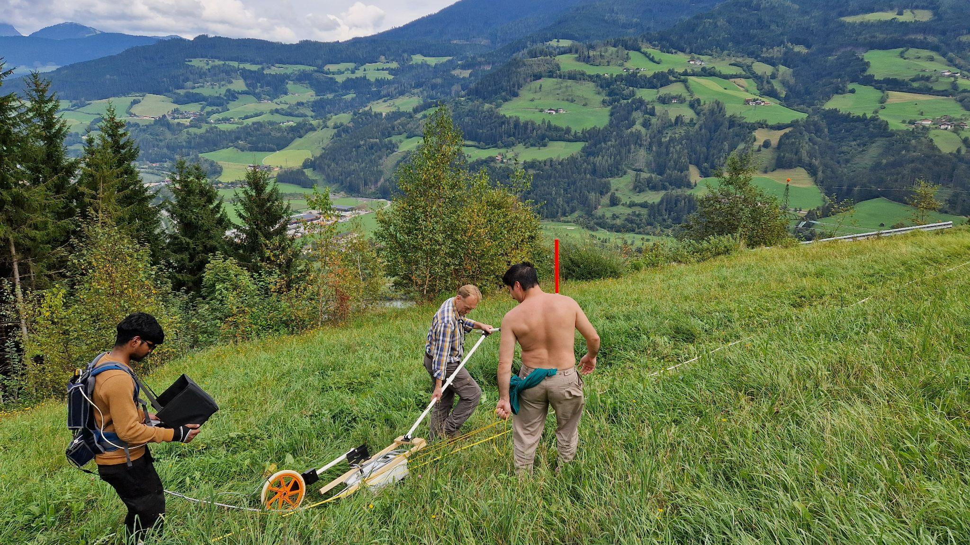
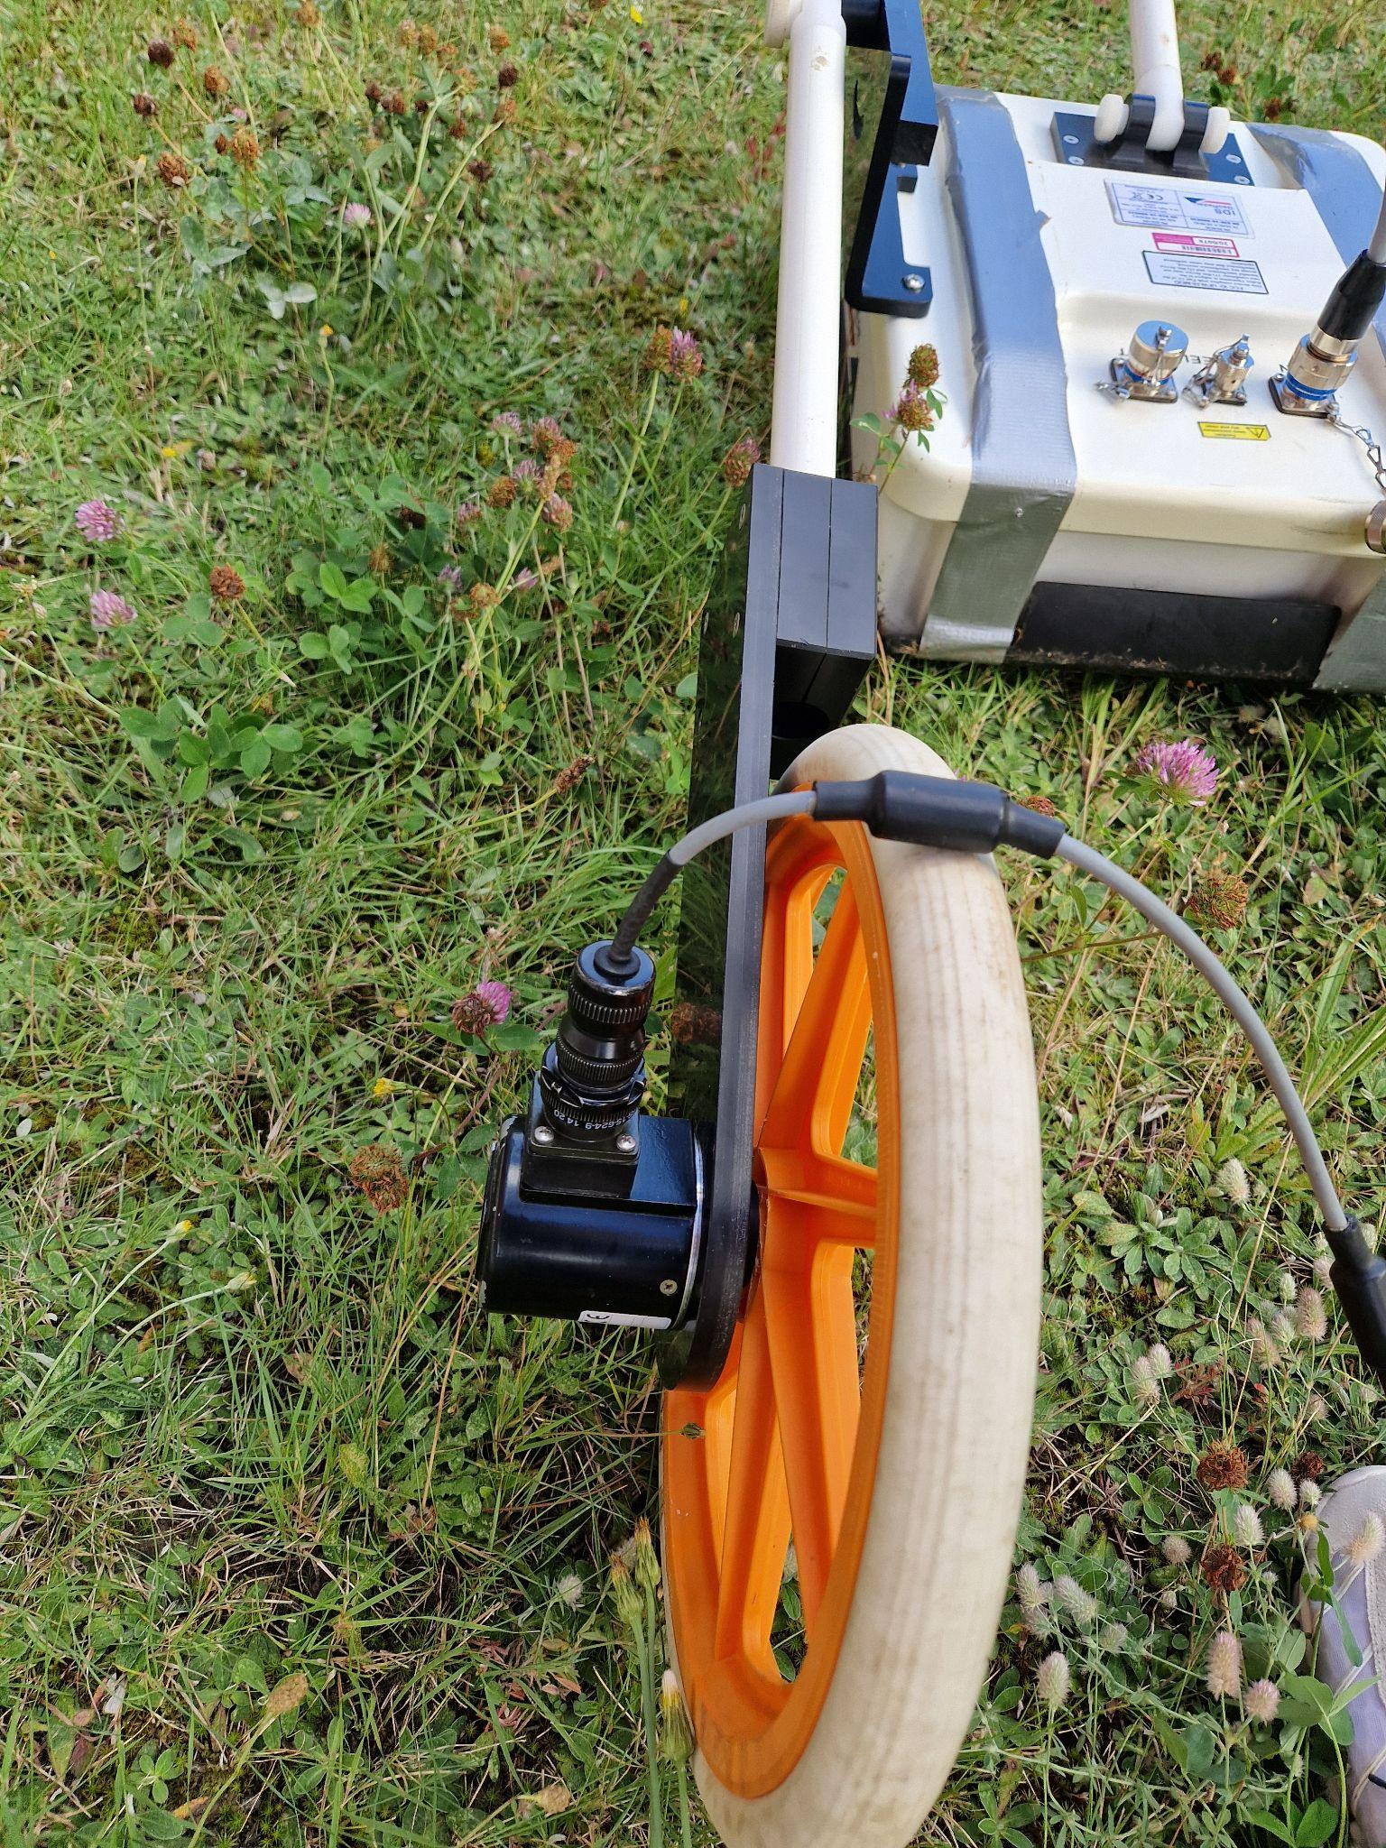
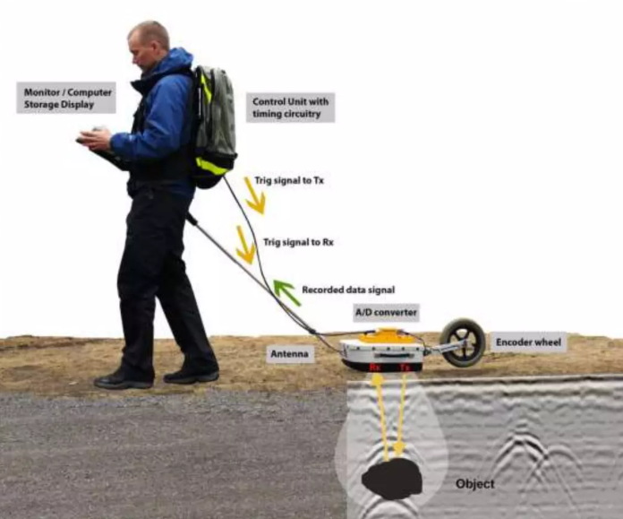
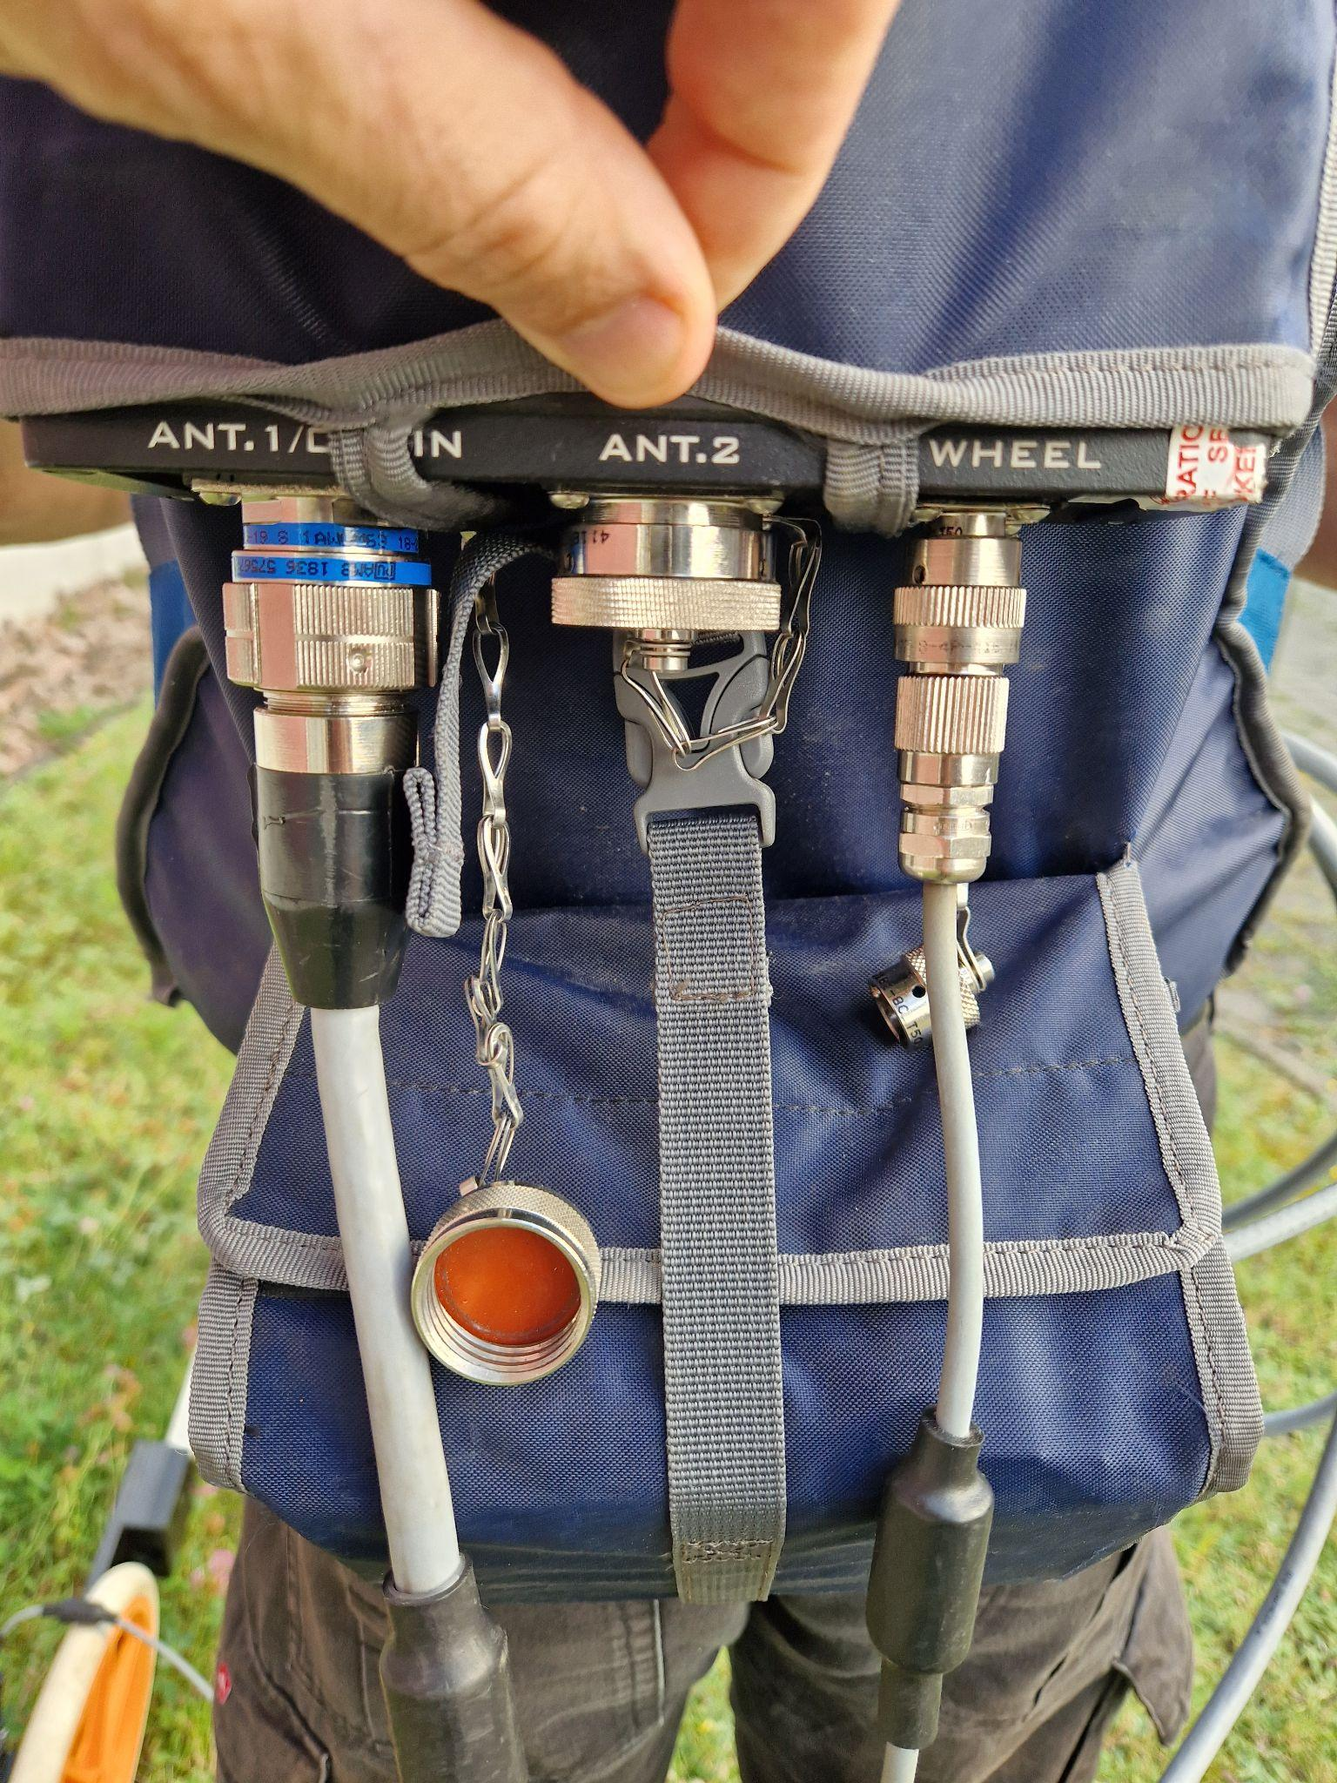
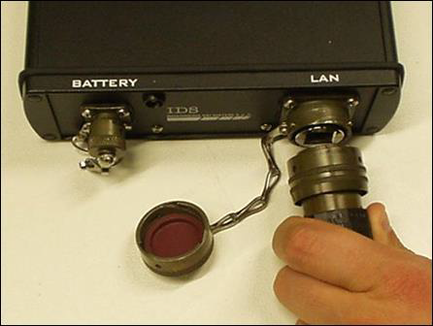
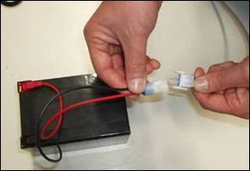
Our equipment :)
A brief explanation before going to the field
IDS Georadar: The Radar System RIS MF Hi Mod 1A consists mainly of four components:
Antenna 200 & 600 MHz
DAD control unit
Two batteries
Laptop Panasonic CF -31
Advanced Geophysical Methods in Natural Resource Investigation
Notes:
Lecture:
The lecture component of this course will provide an overview of advanced geophysical investigation methods used in subsurface exploration. It will cover the principles of magnetometry, geoelectrics, ground-penetrating radar (GPR), and electromagnetic methods, along with an introduction to radiometry and its applications in natural resource exploration. Students will learn about data acquisition techniques for both ground and airborne geophysical surveys, and explore the challenges associated with data interpretation. Additionally, the lecture will address typical workflows used in the processing of geophysical data to ensure accurate results.
Practical training:
The practical training component will focus on providing hands-on experience in fieldwork, utilizing magnetometry, GPR, geoelectric, electromagnetic instruments. Students will actively participate in data acquisition and analysis using specialized software. They will gain experience in processing, and learn how to apply these methods effectively in real exploration scenarios. Practical training will also include the development of field reports and presentations based on data collected during field activities, helping students to refine their skills in communicating technical results

Slide 3
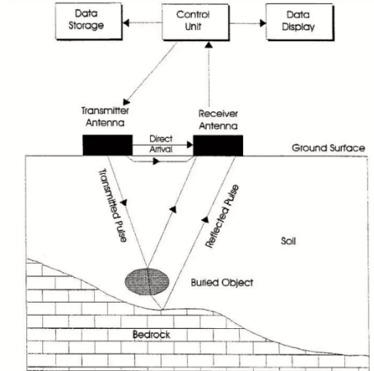
Survey and analysis
A brief explanation before going to the field
GPR uses high frequency radio waves and transmits into the ground.
Advanced Geophysical Methods in Natural Resource Investigation
Notes:
Lecture:
The lecture component of this course will provide an overview of advanced geophysical investigation methods used in subsurface exploration. It will cover the principles of magnetometry, geoelectrics, ground-penetrating radar (GPR), and electromagnetic methods, along with an introduction to radiometry and its applications in natural resource exploration. Students will learn about data acquisition techniques for both ground and airborne geophysical surveys, and explore the challenges associated with data interpretation. Additionally, the lecture will address typical workflows used in the processing of geophysical data to ensure accurate results.
Practical training:
The practical training component will focus on providing hands-on experience in fieldwork, utilizing magnetometry, GPR, geoelectric, electromagnetic instruments. Students will actively participate in data acquisition and analysis using specialized software. They will gain experience in processing, and learn how to apply these methods effectively in real exploration scenarios. Practical training will also include the development of field reports and presentations based on data collected during field activities, helping students to refine their skills in communicating technical results

Slide 4
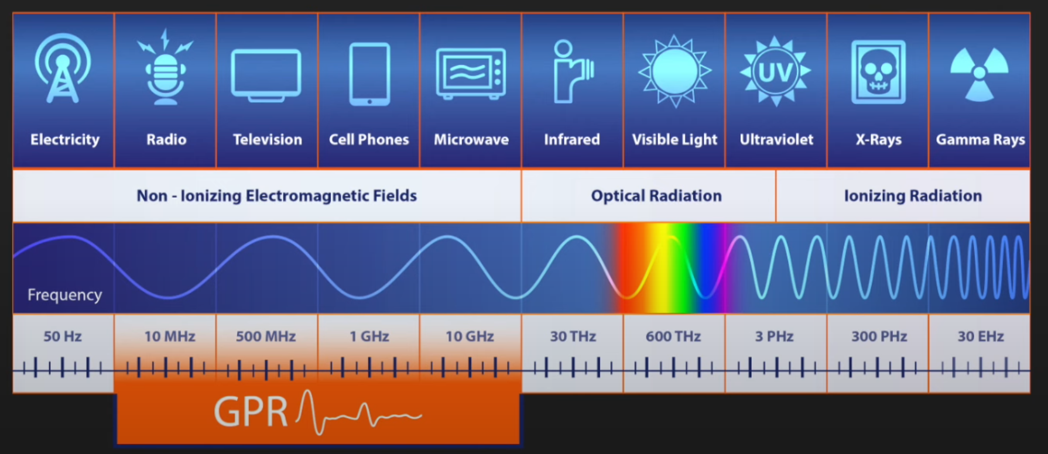
Survey and analysis
A brief explanation before going to the field
GPR uses high frequency radio waves and transmits into the ground.
Electromagnetic spectrum
Advanced Geophysical Methods in Natural Resource Investigation
Notes:
Lecture:
The lecture component of this course will provide an overview of advanced geophysical investigation methods used in subsurface exploration. It will cover the principles of magnetometry, geoelectrics, ground-penetrating radar (GPR), and electromagnetic methods, along with an introduction to radiometry and its applications in natural resource exploration. Students will learn about data acquisition techniques for both ground and airborne geophysical surveys, and explore the challenges associated with data interpretation. Additionally, the lecture will address typical workflows used in the processing of geophysical data to ensure accurate results.
Practical training:
The practical training component will focus on providing hands-on experience in fieldwork, utilizing magnetometry, GPR, geoelectric, electromagnetic instruments. Students will actively participate in data acquisition and analysis using specialized software. They will gain experience in processing, and learn how to apply these methods effectively in real exploration scenarios. Practical training will also include the development of field reports and presentations based on data collected during field activities, helping students to refine their skills in communicating technical results

Slide 5
Survey and analysis
A brief explanation before going to the field
GPR uses high frequency radio waves and transmits into the ground.
When the wave hits a buried object or a boundary with different dielectric constant, the receiving antenna records variations in the reflected return signal.
Advanced Geophysical Methods in Natural Resource Investigation
Notes:
Lecture:
The lecture component of this course will provide an overview of advanced geophysical investigation methods used in subsurface exploration. It will cover the principles of magnetometry, geoelectrics, ground-penetrating radar (GPR), and electromagnetic methods, along with an introduction to radiometry and its applications in natural resource exploration. Students will learn about data acquisition techniques for both ground and airborne geophysical surveys, and explore the challenges associated with data interpretation. Additionally, the lecture will address typical workflows used in the processing of geophysical data to ensure accurate results.
Practical training:
The practical training component will focus on providing hands-on experience in fieldwork, utilizing magnetometry, GPR, geoelectric, electromagnetic instruments. Students will actively participate in data acquisition and analysis using specialized software. They will gain experience in processing, and learn how to apply these methods effectively in real exploration scenarios. Practical training will also include the development of field reports and presentations based on data collected during field activities, helping students to refine their skills in communicating technical results

Slide 6
Survey and analysis
A brief explanation before going to the field
GPR uses high frequency radio waves and transmits into the ground.
When the wave hits a buried object or a boundary with different dielectric constant, the receiving antenna records variations in the reflected return signal.
Electrical conductivity: is the ability of a material to support an electrical current due to an applied electrical field. (sigma)
Advanced Geophysical Methods in Natural Resource Investigation
Notes:
Lecture:
The lecture component of this course will provide an overview of advanced geophysical investigation methods used in subsurface exploration. It will cover the principles of magnetometry, geoelectrics, ground-penetrating radar (GPR), and electromagnetic methods, along with an introduction to radiometry and its applications in natural resource exploration. Students will learn about data acquisition techniques for both ground and airborne geophysical surveys, and explore the challenges associated with data interpretation. Additionally, the lecture will address typical workflows used in the processing of geophysical data to ensure accurate results.
Practical training:
The practical training component will focus on providing hands-on experience in fieldwork, utilizing magnetometry, GPR, geoelectric, electromagnetic instruments. Students will actively participate in data acquisition and analysis using specialized software. They will gain experience in processing, and learn how to apply these methods effectively in real exploration scenarios. Practical training will also include the development of field reports and presentations based on data collected during field activities, helping students to refine their skills in communicating technical results

Slide 7
Survey and analysis
A brief explanation before going to the field
GPR uses high frequency radio waves and transmits into the ground.
When the wave hits a buried object or a boundary with different dielectric constant, the receiving antenna records variations in the reflected return signal.
Electrical conductivity: is the ability of a material to support an electrical current due to an applied electrical field. (sigma)
Dielectric Permittivity: is the property that describes the ability of a material to store electric energy by separating opposite polarity charges in space (epsilon, K).
Advanced Geophysical Methods in Natural Resource Investigation
Notes:
Lecture:
The lecture component of this course will provide an overview of advanced geophysical investigation methods used in subsurface exploration. It will cover the principles of magnetometry, geoelectrics, ground-penetrating radar (GPR), and electromagnetic methods, along with an introduction to radiometry and its applications in natural resource exploration. Students will learn about data acquisition techniques for both ground and airborne geophysical surveys, and explore the challenges associated with data interpretation. Additionally, the lecture will address typical workflows used in the processing of geophysical data to ensure accurate results.
Practical training:
The practical training component will focus on providing hands-on experience in fieldwork, utilizing magnetometry, GPR, geoelectric, electromagnetic instruments. Students will actively participate in data acquisition and analysis using specialized software. They will gain experience in processing, and learn how to apply these methods effectively in real exploration scenarios. Practical training will also include the development of field reports and presentations based on data collected during field activities, helping students to refine their skills in communicating technical results

Slide 8
Survey and analysis
A brief explanation before going to the field
The depth range of GPR is limited by the electrical conductivity of the ground, the transmitted frequency and the radiated power.
As conductivity increases, the penetration depth decreases.
Higher frequencies do not penetrate as far as lower frequencies, but give better resolution.
Advanced Geophysical Methods in Natural Resource Investigation
Notes:
Lecture:
The lecture component of this course will provide an overview of advanced geophysical investigation methods used in subsurface exploration. It will cover the principles of magnetometry, geoelectrics, ground-penetrating radar (GPR), and electromagnetic methods, along with an introduction to radiometry and its applications in natural resource exploration. Students will learn about data acquisition techniques for both ground and airborne geophysical surveys, and explore the challenges associated with data interpretation. Additionally, the lecture will address typical workflows used in the processing of geophysical data to ensure accurate results.
Practical training:
The practical training component will focus on providing hands-on experience in fieldwork, utilizing magnetometry, GPR, geoelectric, electromagnetic instruments. Students will actively participate in data acquisition and analysis using specialized software. They will gain experience in processing, and learn how to apply these methods effectively in real exploration scenarios. Practical training will also include the development of field reports and presentations based on data collected during field activities, helping students to refine their skills in communicating technical results

Slide 9
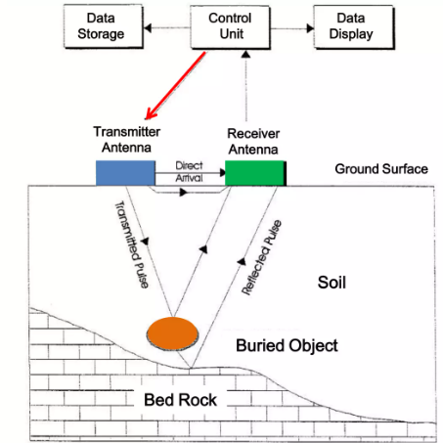
Survey and analysis
A brief explanation before going to the field
The depth range of GPR is limited by the electrical conductivity of the ground, the transmitted frequency and the radiated power.
As conductivity increases, the penetration depth decreases.
Higher frequencies do not penetrate as far as lower frequencies, but give better resolution.
Advanced Geophysical Methods in Natural Resource Investigation
Notes:
Lecture:
The lecture component of this course will provide an overview of advanced geophysical investigation methods used in subsurface exploration. It will cover the principles of magnetometry, geoelectrics, ground-penetrating radar (GPR), and electromagnetic methods, along with an introduction to radiometry and its applications in natural resource exploration. Students will learn about data acquisition techniques for both ground and airborne geophysical surveys, and explore the challenges associated with data interpretation. Additionally, the lecture will address typical workflows used in the processing of geophysical data to ensure accurate results.
Practical training:
The practical training component will focus on providing hands-on experience in fieldwork, utilizing magnetometry, GPR, geoelectric, electromagnetic instruments. Students will actively participate in data acquisition and analysis using specialized software. They will gain experience in processing, and learn how to apply these methods effectively in real exploration scenarios. Practical training will also include the development of field reports and presentations based on data collected during field activities, helping students to refine their skills in communicating technical results

Slide 10
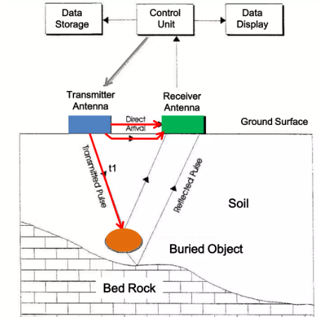
Survey and analysis
A brief explanation before going to the field
The depth range of GPR is limited by the electrical conductivity of the ground, the transmitted frequency and the radiated power.
As conductivity increases, the penetration depth decreases.
Higher frequencies do not penetrate as far as lower frequencies, but give better resolution.
Advanced Geophysical Methods in Natural Resource Investigation
Notes:
Lecture:
The lecture component of this course will provide an overview of advanced geophysical investigation methods used in subsurface exploration. It will cover the principles of magnetometry, geoelectrics, ground-penetrating radar (GPR), and electromagnetic methods, along with an introduction to radiometry and its applications in natural resource exploration. Students will learn about data acquisition techniques for both ground and airborne geophysical surveys, and explore the challenges associated with data interpretation. Additionally, the lecture will address typical workflows used in the processing of geophysical data to ensure accurate results.
Practical training:
The practical training component will focus on providing hands-on experience in fieldwork, utilizing magnetometry, GPR, geoelectric, electromagnetic instruments. Students will actively participate in data acquisition and analysis using specialized software. They will gain experience in processing, and learn how to apply these methods effectively in real exploration scenarios. Practical training will also include the development of field reports and presentations based on data collected during field activities, helping students to refine their skills in communicating technical results

Slide 11
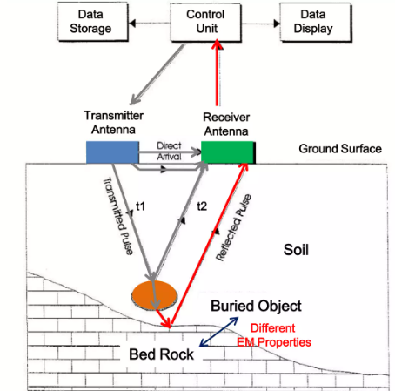
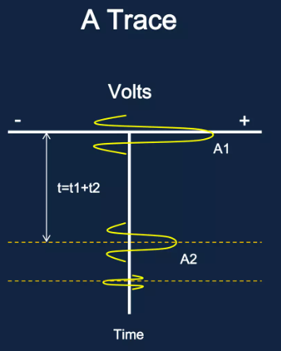
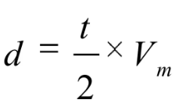
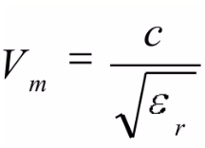

Survey and analysis
A brief explanation before going to the field
Signal Shape → Amplitude & time
GPR registers the amplitude and the time of the arrival of the signals
Depth
Propagation velocity through the material
C propagation velocity in free space
relative permittivity
Advanced Geophysical Methods in Natural Resource Investigation
Notes:
Lecture:
The lecture component of this course will provide an overview of advanced geophysical investigation methods used in subsurface exploration. It will cover the principles of magnetometry, geoelectrics, ground-penetrating radar (GPR), and electromagnetic methods, along with an introduction to radiometry and its applications in natural resource exploration. Students will learn about data acquisition techniques for both ground and airborne geophysical surveys, and explore the challenges associated with data interpretation. Additionally, the lecture will address typical workflows used in the processing of geophysical data to ensure accurate results.
Practical training:
The practical training component will focus on providing hands-on experience in fieldwork, utilizing magnetometry, GPR, geoelectric, electromagnetic instruments. Students will actively participate in data acquisition and analysis using specialized software. They will gain experience in processing, and learn how to apply these methods effectively in real exploration scenarios. Practical training will also include the development of field reports and presentations based on data collected during field activities, helping students to refine their skills in communicating technical results

Slide 12
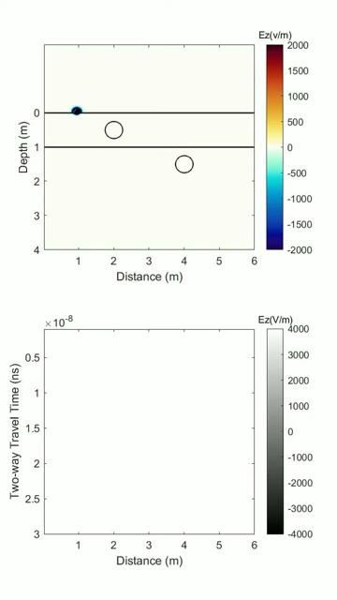
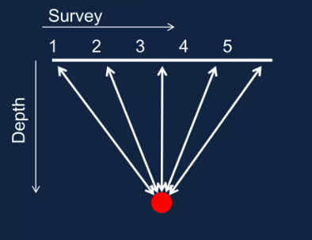
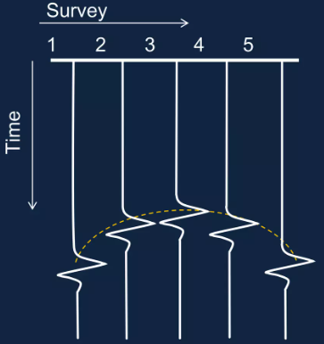
Point reflector → signal shape
A brief explanation before going to the field
Point Reflector
A Series of Traces
Line Scans (BScan, Radargram)
Advanced Geophysical Methods in Natural Resource Investigation
Notes:
Lecture:
The lecture component of this course will provide an overview of advanced geophysical investigation methods used in subsurface exploration. It will cover the principles of magnetometry, geoelectrics, ground-penetrating radar (GPR), and electromagnetic methods, along with an introduction to radiometry and its applications in natural resource exploration. Students will learn about data acquisition techniques for both ground and airborne geophysical surveys, and explore the challenges associated with data interpretation. Additionally, the lecture will address typical workflows used in the processing of geophysical data to ensure accurate results.
Practical training:
The practical training component will focus on providing hands-on experience in fieldwork, utilizing magnetometry, GPR, geoelectric, electromagnetic instruments. Students will actively participate in data acquisition and analysis using specialized software. They will gain experience in processing, and learn how to apply these methods effectively in real exploration scenarios. Practical training will also include the development of field reports and presentations based on data collected during field activities, helping students to refine their skills in communicating technical results

Slide 13
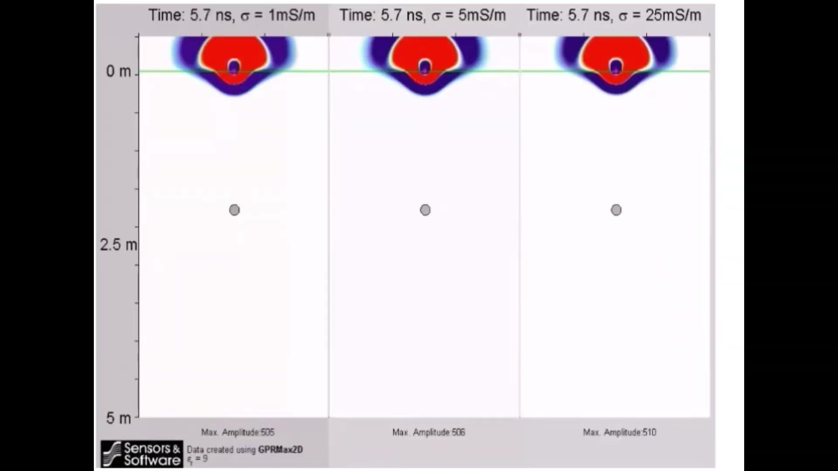
Point reflector → effects when the conductivity of medium changes
A brief explanation before going to the field
Advanced Geophysical Methods in Natural Resource Investigation
Notes:
Lecture:
The lecture component of this course will provide an overview of advanced geophysical investigation methods used in subsurface exploration. It will cover the principles of magnetometry, geoelectrics, ground-penetrating radar (GPR), and electromagnetic methods, along with an introduction to radiometry and its applications in natural resource exploration. Students will learn about data acquisition techniques for both ground and airborne geophysical surveys, and explore the challenges associated with data interpretation. Additionally, the lecture will address typical workflows used in the processing of geophysical data to ensure accurate results.
Practical training:
The practical training component will focus on providing hands-on experience in fieldwork, utilizing magnetometry, GPR, geoelectric, electromagnetic instruments. Students will actively participate in data acquisition and analysis using specialized software. They will gain experience in processing, and learn how to apply these methods effectively in real exploration scenarios. Practical training will also include the development of field reports and presentations based on data collected during field activities, helping students to refine their skills in communicating technical results

Slide 14
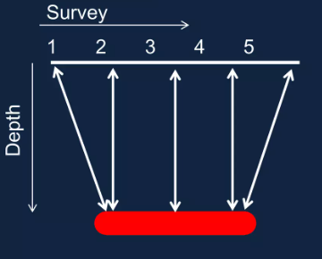
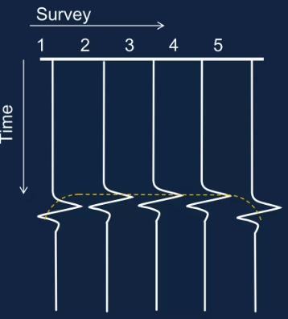
Line Reflector → signal shape
A brief explanation before going to the field
horitzontal Reflector
A Series of Traces
Advanced Geophysical Methods in Natural Resource Investigation
Notes:
Lecture:
The lecture component of this course will provide an overview of advanced geophysical investigation methods used in subsurface exploration. It will cover the principles of magnetometry, geoelectrics, ground-penetrating radar (GPR), and electromagnetic methods, along with an introduction to radiometry and its applications in natural resource exploration. Students will learn about data acquisition techniques for both ground and airborne geophysical surveys, and explore the challenges associated with data interpretation. Additionally, the lecture will address typical workflows used in the processing of geophysical data to ensure accurate results.
Practical training:
The practical training component will focus on providing hands-on experience in fieldwork, utilizing magnetometry, GPR, geoelectric, electromagnetic instruments. Students will actively participate in data acquisition and analysis using specialized software. They will gain experience in processing, and learn how to apply these methods effectively in real exploration scenarios. Practical training will also include the development of field reports and presentations based on data collected during field activities, helping students to refine their skills in communicating technical results

Slide 15
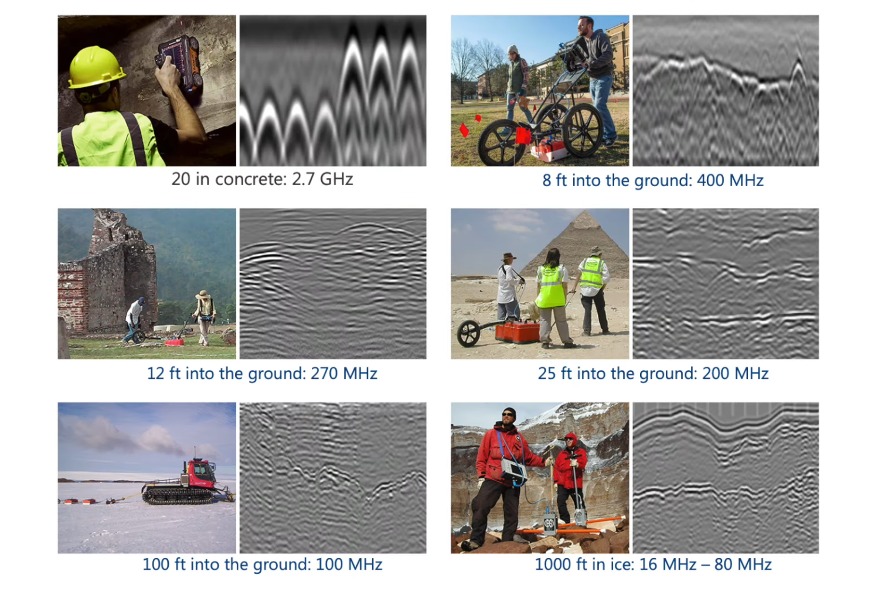
Antenna Frequency
A brief explanation before going to the field
Low Frequency
12.5 -200 MHz
Long wavelength
Deep prospection (up to 150 feet deep)
Geological and geophysical applications
High Frequency
800-2600 MHz
Short wavelength
Shallow prospection (as little as 12 inches)
Concrete scanning and utility locating
Advanced Geophysical Methods in Natural Resource Investigation
Notes:
Lecture:
The lecture component of this course will provide an overview of advanced geophysical investigation methods used in subsurface exploration. It will cover the principles of magnetometry, geoelectrics, ground-penetrating radar (GPR), and electromagnetic methods, along with an introduction to radiometry and its applications in natural resource exploration. Students will learn about data acquisition techniques for both ground and airborne geophysical surveys, and explore the challenges associated with data interpretation. Additionally, the lecture will address typical workflows used in the processing of geophysical data to ensure accurate results.
Practical training:
The practical training component will focus on providing hands-on experience in fieldwork, utilizing magnetometry, GPR, geoelectric, electromagnetic instruments. Students will actively participate in data acquisition and analysis using specialized software. They will gain experience in processing, and learn how to apply these methods effectively in real exploration scenarios. Practical training will also include the development of field reports and presentations based on data collected during field activities, helping students to refine their skills in communicating technical results

Slide 16
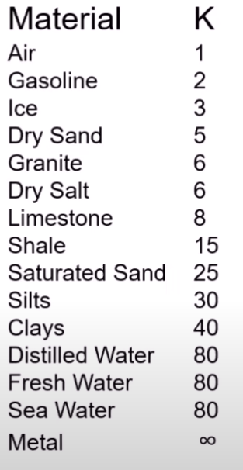
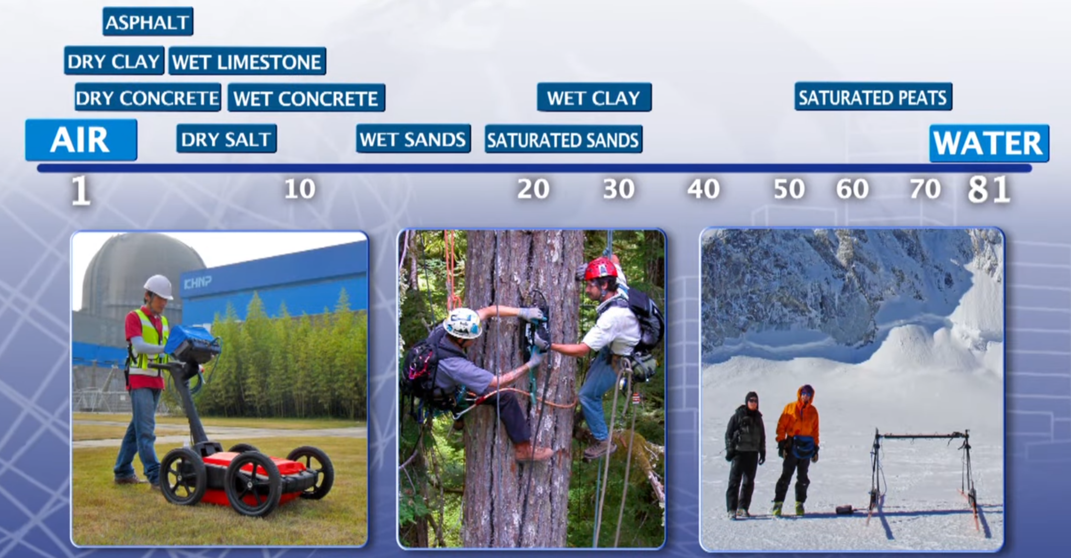
Every Material has a Dielectric Constant (K)
A brief explanation before going to the field
Advanced Geophysical Methods in Natural Resource Investigation
Notes:
Lecture:
The lecture component of this course will provide an overview of advanced geophysical investigation methods used in subsurface exploration. It will cover the principles of magnetometry, geoelectrics, ground-penetrating radar (GPR), and electromagnetic methods, along with an introduction to radiometry and its applications in natural resource exploration. Students will learn about data acquisition techniques for both ground and airborne geophysical surveys, and explore the challenges associated with data interpretation. Additionally, the lecture will address typical workflows used in the processing of geophysical data to ensure accurate results.
Practical training:
The practical training component will focus on providing hands-on experience in fieldwork, utilizing magnetometry, GPR, geoelectric, electromagnetic instruments. Students will actively participate in data acquisition and analysis using specialized software. They will gain experience in processing, and learn how to apply these methods effectively in real exploration scenarios. Practical training will also include the development of field reports and presentations based on data collected during field activities, helping students to refine their skills in communicating technical results

Slide 17
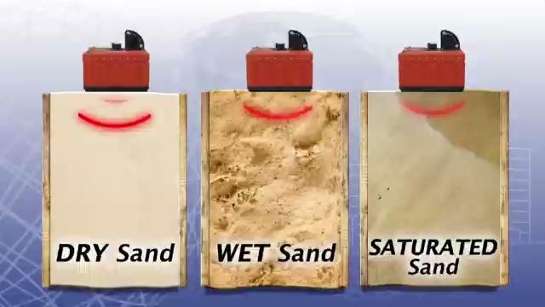
The Dielectric Constant (K) affects the wave velocity
A brief explanation before going to the field
Advanced Geophysical Methods in Natural Resource Investigation
Notes:
Lecture:
The lecture component of this course will provide an overview of advanced geophysical investigation methods used in subsurface exploration. It will cover the principles of magnetometry, geoelectrics, ground-penetrating radar (GPR), and electromagnetic methods, along with an introduction to radiometry and its applications in natural resource exploration. Students will learn about data acquisition techniques for both ground and airborne geophysical surveys, and explore the challenges associated with data interpretation. Additionally, the lecture will address typical workflows used in the processing of geophysical data to ensure accurate results.
Practical training:
The practical training component will focus on providing hands-on experience in fieldwork, utilizing magnetometry, GPR, geoelectric, electromagnetic instruments. Students will actively participate in data acquisition and analysis using specialized software. They will gain experience in processing, and learn how to apply these methods effectively in real exploration scenarios. Practical training will also include the development of field reports and presentations based on data collected during field activities, helping students to refine their skills in communicating technical results

Slide 18
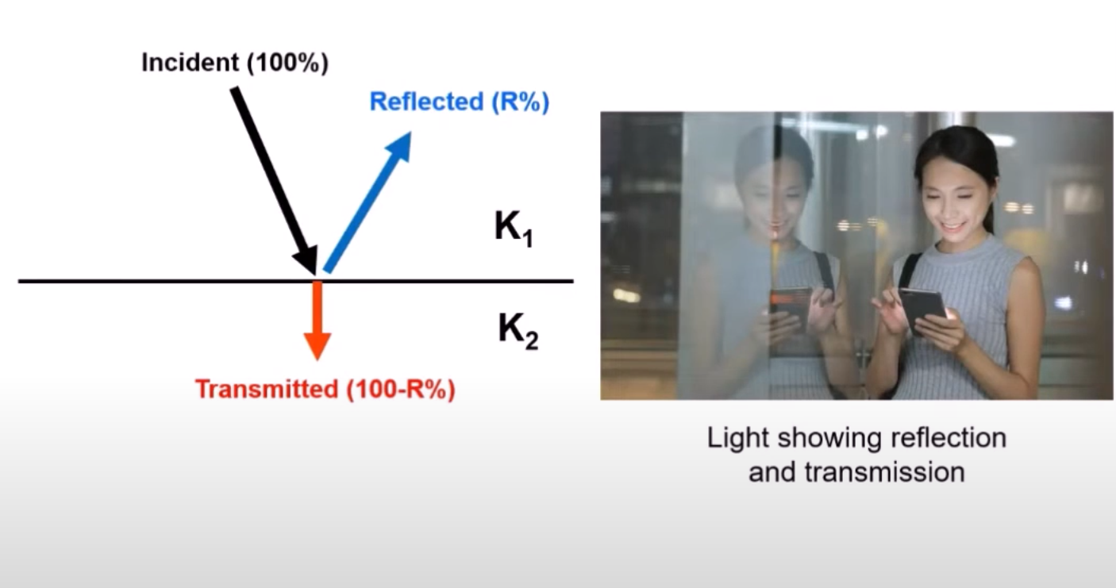
Reflections are created by contrasts
A brief explanation before going to the field
Advanced Geophysical Methods in Natural Resource Investigation
Notes:
Lecture:
The lecture component of this course will provide an overview of advanced geophysical investigation methods used in subsurface exploration. It will cover the principles of magnetometry, geoelectrics, ground-penetrating radar (GPR), and electromagnetic methods, along with an introduction to radiometry and its applications in natural resource exploration. Students will learn about data acquisition techniques for both ground and airborne geophysical surveys, and explore the challenges associated with data interpretation. Additionally, the lecture will address typical workflows used in the processing of geophysical data to ensure accurate results.
Practical training:
The practical training component will focus on providing hands-on experience in fieldwork, utilizing magnetometry, GPR, geoelectric, electromagnetic instruments. Students will actively participate in data acquisition and analysis using specialized software. They will gain experience in processing, and learn how to apply these methods effectively in real exploration scenarios. Practical training will also include the development of field reports and presentations based on data collected during field activities, helping students to refine their skills in communicating technical results

Slide 19
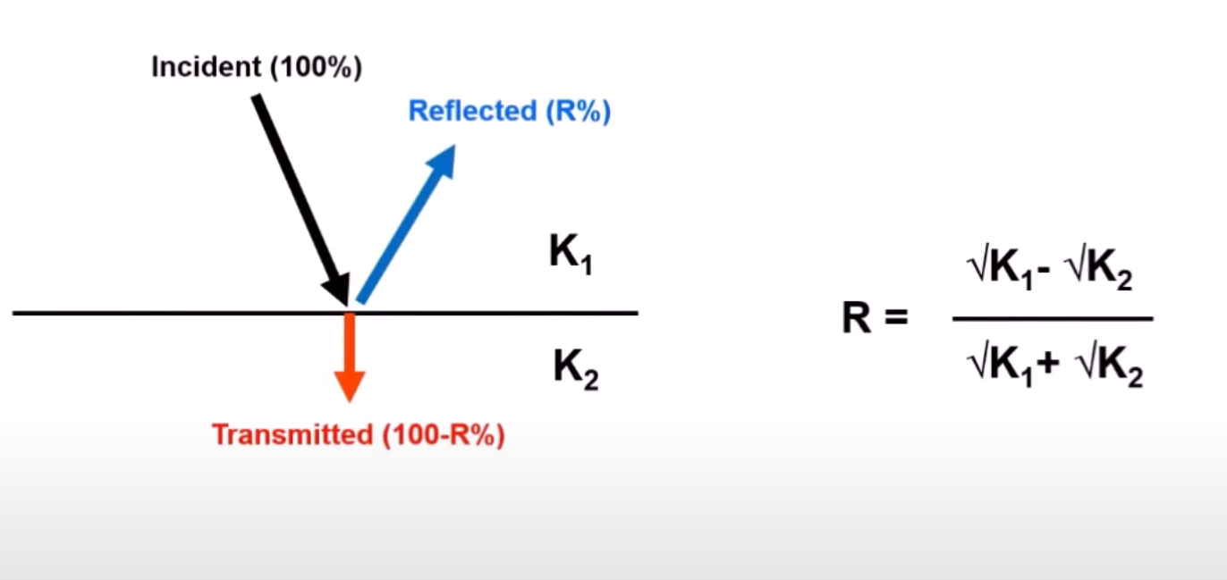
Reflections are created by contrasts
A brief explanation before going to the field
Advanced Geophysical Methods in Natural Resource Investigation
Notes:
Lecture:
The lecture component of this course will provide an overview of advanced geophysical investigation methods used in subsurface exploration. It will cover the principles of magnetometry, geoelectrics, ground-penetrating radar (GPR), and electromagnetic methods, along with an introduction to radiometry and its applications in natural resource exploration. Students will learn about data acquisition techniques for both ground and airborne geophysical surveys, and explore the challenges associated with data interpretation. Additionally, the lecture will address typical workflows used in the processing of geophysical data to ensure accurate results.
Practical training:
The practical training component will focus on providing hands-on experience in fieldwork, utilizing magnetometry, GPR, geoelectric, electromagnetic instruments. Students will actively participate in data acquisition and analysis using specialized software. They will gain experience in processing, and learn how to apply these methods effectively in real exploration scenarios. Practical training will also include the development of field reports and presentations based on data collected during field activities, helping students to refine their skills in communicating technical results

Slide 20
Reflection Strength depends on the contrast of materials
A brief explanation before going to the field
Material 1 | K1 | Material 2 | K2 | Reflectivity
Dry Sand | 5 | Rock | 6 | -5%
Wet Sand | 25 | Rock | 6 | 34%
Dry Sand | 5 | Wet Sand | 25 | -38%
Rock | 6 | Air | 1 | 42%
Water | 80 | Rock | 6 | 57%
Ice | 3 | Water | 80 | 67%
Soil | 12 | Metal | infinito | 100%
Advanced Geophysical Methods in Natural Resource Investigation
Notes:
Lecture:
The lecture component of this course will provide an overview of advanced geophysical investigation methods used in subsurface exploration. It will cover the principles of magnetometry, geoelectrics, ground-penetrating radar (GPR), and electromagnetic methods, along with an introduction to radiometry and its applications in natural resource exploration. Students will learn about data acquisition techniques for both ground and airborne geophysical surveys, and explore the challenges associated with data interpretation. Additionally, the lecture will address typical workflows used in the processing of geophysical data to ensure accurate results.
Practical training:
The practical training component will focus on providing hands-on experience in fieldwork, utilizing magnetometry, GPR, geoelectric, electromagnetic instruments. Students will actively participate in data acquisition and analysis using specialized software. They will gain experience in processing, and learn how to apply these methods effectively in real exploration scenarios. Practical training will also include the development of field reports and presentations based on data collected during field activities, helping students to refine their skills in communicating technical results

Slide 21
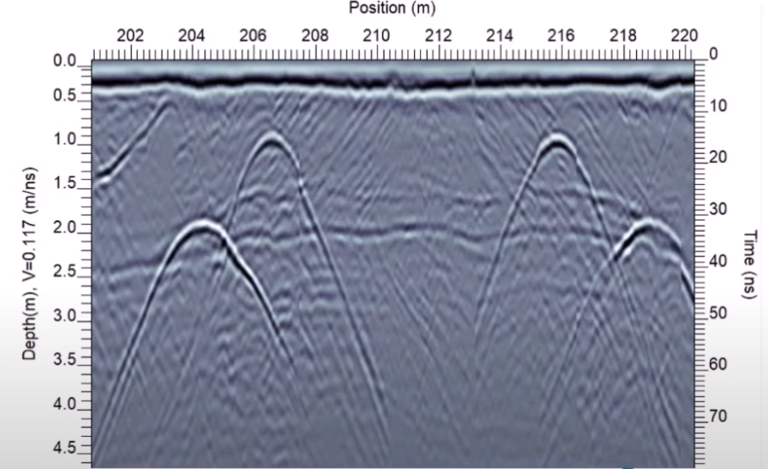
Reflection Strength depends on the contrast of materials
A brief explanation before going to the field
Material 1 | K1 | Material 2 | K2 | Reflectivity
Dry Sand | 5 | Rock | 6 | -5%
Wet Sand | 25 | Rock | 6 | 34%
Dry Sand | 5 | Wet Sand | 25 | -38%
Rock | 6 | Air | 1 | 42%
Water | 80 | Rock | 6 | 57%
Ice | 3 | Water | 80 | 67%
Soil | 12 | Metal | infinito | 100%
Dry Sand over Rock
Advanced Geophysical Methods in Natural Resource Investigation
Notes:
Lecture:
The lecture component of this course will provide an overview of advanced geophysical investigation methods used in subsurface exploration. It will cover the principles of magnetometry, geoelectrics, ground-penetrating radar (GPR), and electromagnetic methods, along with an introduction to radiometry and its applications in natural resource exploration. Students will learn about data acquisition techniques for both ground and airborne geophysical surveys, and explore the challenges associated with data interpretation. Additionally, the lecture will address typical workflows used in the processing of geophysical data to ensure accurate results.
Practical training:
The practical training component will focus on providing hands-on experience in fieldwork, utilizing magnetometry, GPR, geoelectric, electromagnetic instruments. Students will actively participate in data acquisition and analysis using specialized software. They will gain experience in processing, and learn how to apply these methods effectively in real exploration scenarios. Practical training will also include the development of field reports and presentations based on data collected during field activities, helping students to refine their skills in communicating technical results

Slide 22
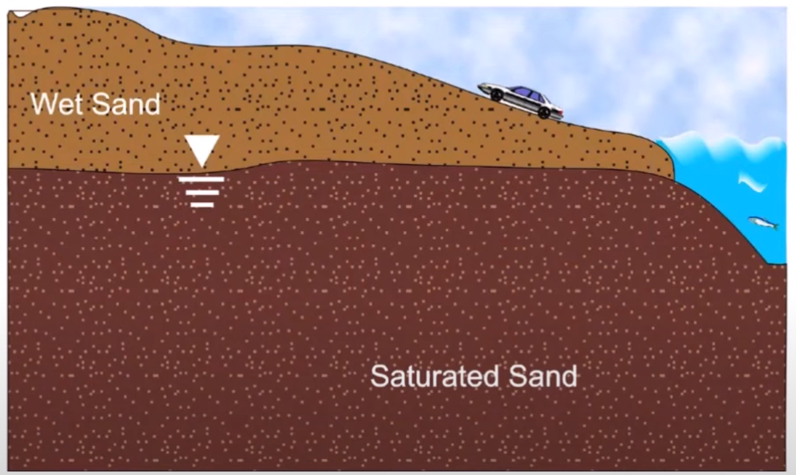
Reflection Strength depends on the contrast of materials
A brief explanation before going to the field
Material 1 | K1 | Material 2 | K2 | Reflectivity
Dry Sand | 5 | Rock | 6 | -5%
Wet Sand | 25 | Rock | 6 | 34%
Dry Sand | 5 | Wet Sand | 25 | -38%
Rock | 6 | Air | 1 | 42%
Water | 80 | Rock | 6 | 57%
Ice | 3 | Water | 80 | 67%
Soil | 12 | Metal | infinito | 100%
Dry Sand over Wet Sand
Advanced Geophysical Methods in Natural Resource Investigation
Notes:
Lecture:
The lecture component of this course will provide an overview of advanced geophysical investigation methods used in subsurface exploration. It will cover the principles of magnetometry, geoelectrics, ground-penetrating radar (GPR), and electromagnetic methods, along with an introduction to radiometry and its applications in natural resource exploration. Students will learn about data acquisition techniques for both ground and airborne geophysical surveys, and explore the challenges associated with data interpretation. Additionally, the lecture will address typical workflows used in the processing of geophysical data to ensure accurate results.
Practical training:
The practical training component will focus on providing hands-on experience in fieldwork, utilizing magnetometry, GPR, geoelectric, electromagnetic instruments. Students will actively participate in data acquisition and analysis using specialized software. They will gain experience in processing, and learn how to apply these methods effectively in real exploration scenarios. Practical training will also include the development of field reports and presentations based on data collected during field activities, helping students to refine their skills in communicating technical results

Slide 23
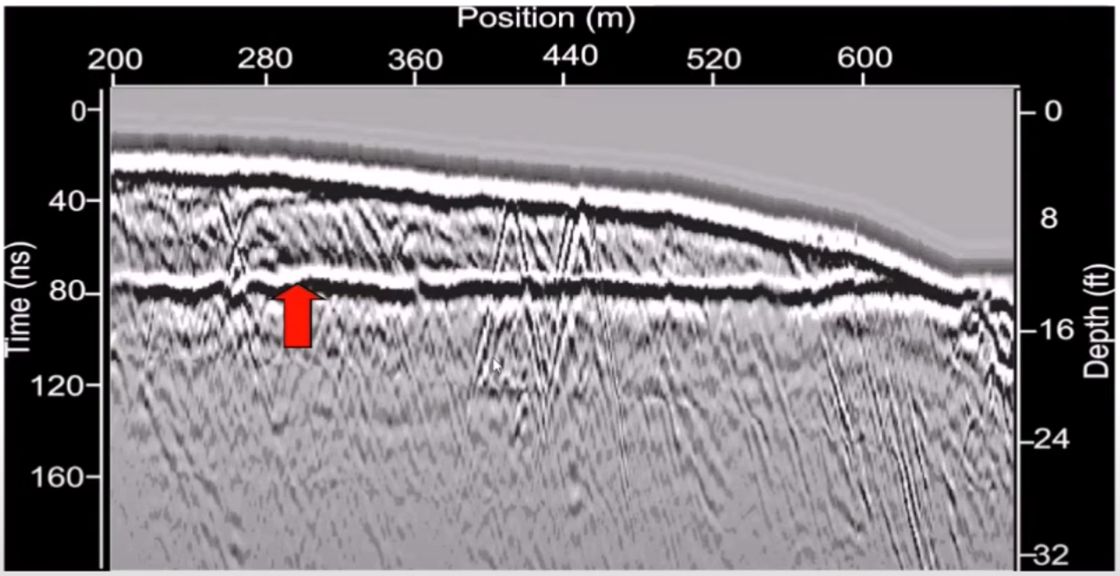
Reflection Strength depends on the contrast of materials
A brief explanation before going to the field
Material 1 | K1 | Material 2 | K2 | Reflectivity
Dry Sand | 5 | Rock | 6 | -5%
Wet Sand | 25 | Rock | 6 | 34%
Dry Sand | 5 | Wet Sand | 25 | -38%
Rock | 6 | Air | 1 | 42%
Water | 80 | Rock | 6 | 57%
Ice | 3 | Water | 80 | 67%
Soil | 12 | Metal | infinito | 100%
Dry Sand over Wet Sand
Advanced Geophysical Methods in Natural Resource Investigation
Notes:
Lecture:
The lecture component of this course will provide an overview of advanced geophysical investigation methods used in subsurface exploration. It will cover the principles of magnetometry, geoelectrics, ground-penetrating radar (GPR), and electromagnetic methods, along with an introduction to radiometry and its applications in natural resource exploration. Students will learn about data acquisition techniques for both ground and airborne geophysical surveys, and explore the challenges associated with data interpretation. Additionally, the lecture will address typical workflows used in the processing of geophysical data to ensure accurate results.
Practical training:
The practical training component will focus on providing hands-on experience in fieldwork, utilizing magnetometry, GPR, geoelectric, electromagnetic instruments. Students will actively participate in data acquisition and analysis using specialized software. They will gain experience in processing, and learn how to apply these methods effectively in real exploration scenarios. Practical training will also include the development of field reports and presentations based on data collected during field activities, helping students to refine their skills in communicating technical results

Slide 24
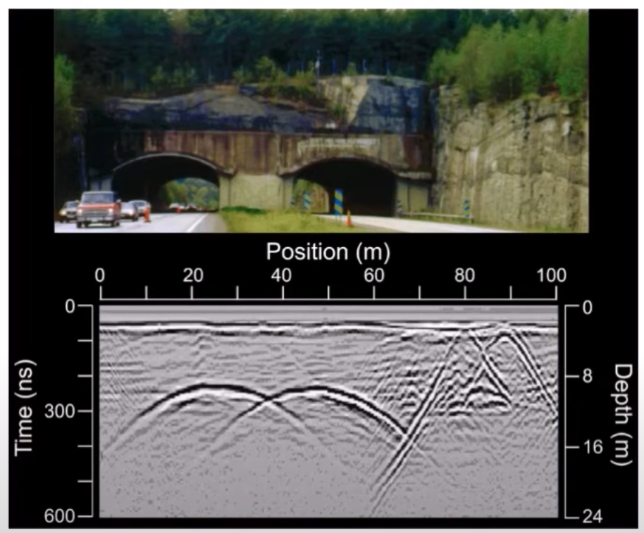
Reflection Strength depends on the contrast of materials
A brief explanation before going to the field
Material 1 | K1 | Material 2 | K2 | Reflectivity
Dry Sand | 5 | Rock | 6 | -5%
Wet Sand | 25 | Rock | 6 | 34%
Dry Sand | 5 | Wet Sand | 25 | -38%
Rock | 6 | Air | 1 | 42%
Water | 80 | Rock | 6 | 57%
Ice | 3 | Water | 80 | 67%
Soil | 12 | Metal | infinito | 100%
Cavity in Rock
Advanced Geophysical Methods in Natural Resource Investigation
Notes:
Lecture:
The lecture component of this course will provide an overview of advanced geophysical investigation methods used in subsurface exploration. It will cover the principles of magnetometry, geoelectrics, ground-penetrating radar (GPR), and electromagnetic methods, along with an introduction to radiometry and its applications in natural resource exploration. Students will learn about data acquisition techniques for both ground and airborne geophysical surveys, and explore the challenges associated with data interpretation. Additionally, the lecture will address typical workflows used in the processing of geophysical data to ensure accurate results.
Practical training:
The practical training component will focus on providing hands-on experience in fieldwork, utilizing magnetometry, GPR, geoelectric, electromagnetic instruments. Students will actively participate in data acquisition and analysis using specialized software. They will gain experience in processing, and learn how to apply these methods effectively in real exploration scenarios. Practical training will also include the development of field reports and presentations based on data collected during field activities, helping students to refine their skills in communicating technical results

Slide 25
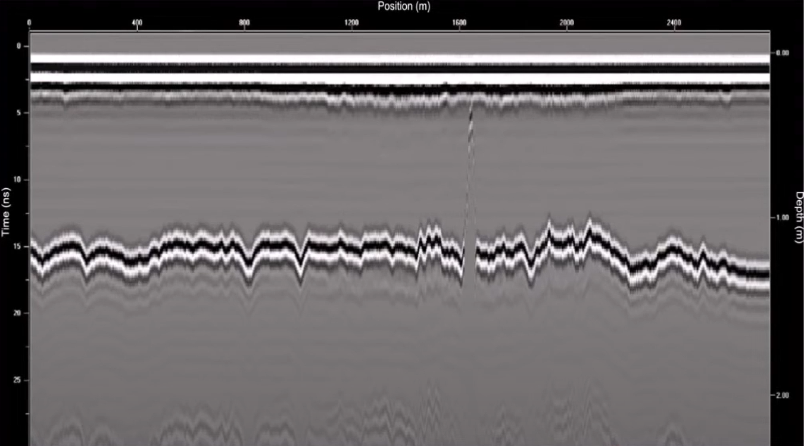
Reflection Strength depends on the contrast of materials
A brief explanation before going to the field
Material 1 | K1 | Material 2 | K2 | Reflectivity
Dry Sand | 5 | Rock | 6 | -5%
Wet Sand | 25 | Rock | 6 | 34%
Dry Sand | 5 | Wet Sand | 25 | -38%
Rock | 6 | Air | 1 | 42%
Water | 80 | Rock | 6 | 57%
Ice | 3 | Water | 80 | 67%
Soil | 12 | Metal | infinito | 100%
Ice over Water
Advanced Geophysical Methods in Natural Resource Investigation
Notes:
Lecture:
The lecture component of this course will provide an overview of advanced geophysical investigation methods used in subsurface exploration. It will cover the principles of magnetometry, geoelectrics, ground-penetrating radar (GPR), and electromagnetic methods, along with an introduction to radiometry and its applications in natural resource exploration. Students will learn about data acquisition techniques for both ground and airborne geophysical surveys, and explore the challenges associated with data interpretation. Additionally, the lecture will address typical workflows used in the processing of geophysical data to ensure accurate results.
Practical training:
The practical training component will focus on providing hands-on experience in fieldwork, utilizing magnetometry, GPR, geoelectric, electromagnetic instruments. Students will actively participate in data acquisition and analysis using specialized software. They will gain experience in processing, and learn how to apply these methods effectively in real exploration scenarios. Practical training will also include the development of field reports and presentations based on data collected during field activities, helping students to refine their skills in communicating technical results

Slide 26
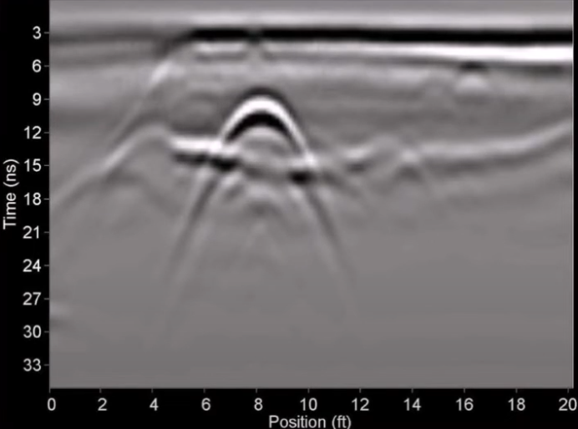
Reflection Strength depends on the contrast of materials
A brief explanation before going to the field
Material 1 | K1 | Material 2 | K2 | Reflectivity
Dry Sand | 5 | Rock | 6 | -5%
Wet Sand | 25 | Rock | 6 | 34%
Dry Sand | 5 | Wet Sand | 25 | -38%
Rock | 6 | Air | 1 | 42%
Water | 80 | Rock | 6 | 57%
Ice | 3 | Water | 80 | 67%
Soil | 12 | Metal | infinito | 100%
Metal Utility in Soil
Advanced Geophysical Methods in Natural Resource Investigation
Notes:
Lecture:
The lecture component of this course will provide an overview of advanced geophysical investigation methods used in subsurface exploration. It will cover the principles of magnetometry, geoelectrics, ground-penetrating radar (GPR), and electromagnetic methods, along with an introduction to radiometry and its applications in natural resource exploration. Students will learn about data acquisition techniques for both ground and airborne geophysical surveys, and explore the challenges associated with data interpretation. Additionally, the lecture will address typical workflows used in the processing of geophysical data to ensure accurate results.
Practical training:
The practical training component will focus on providing hands-on experience in fieldwork, utilizing magnetometry, GPR, geoelectric, electromagnetic instruments. Students will actively participate in data acquisition and analysis using specialized software. They will gain experience in processing, and learn how to apply these methods effectively in real exploration scenarios. Practical training will also include the development of field reports and presentations based on data collected during field activities, helping students to refine their skills in communicating technical results

Slide 27
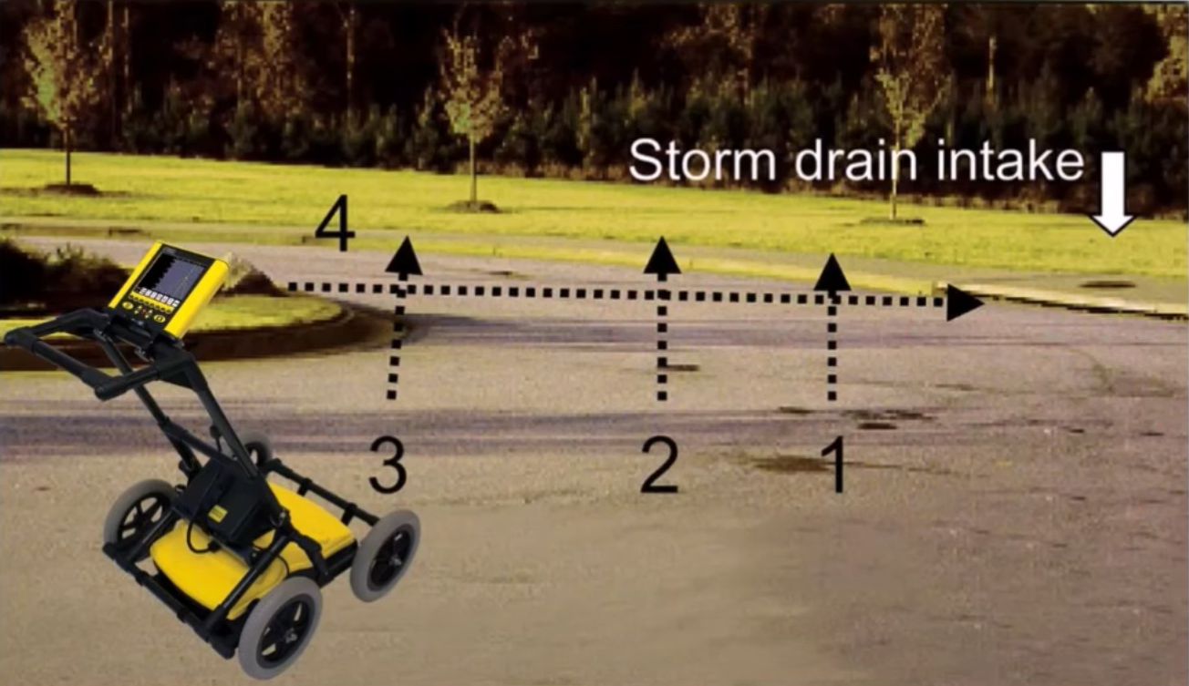
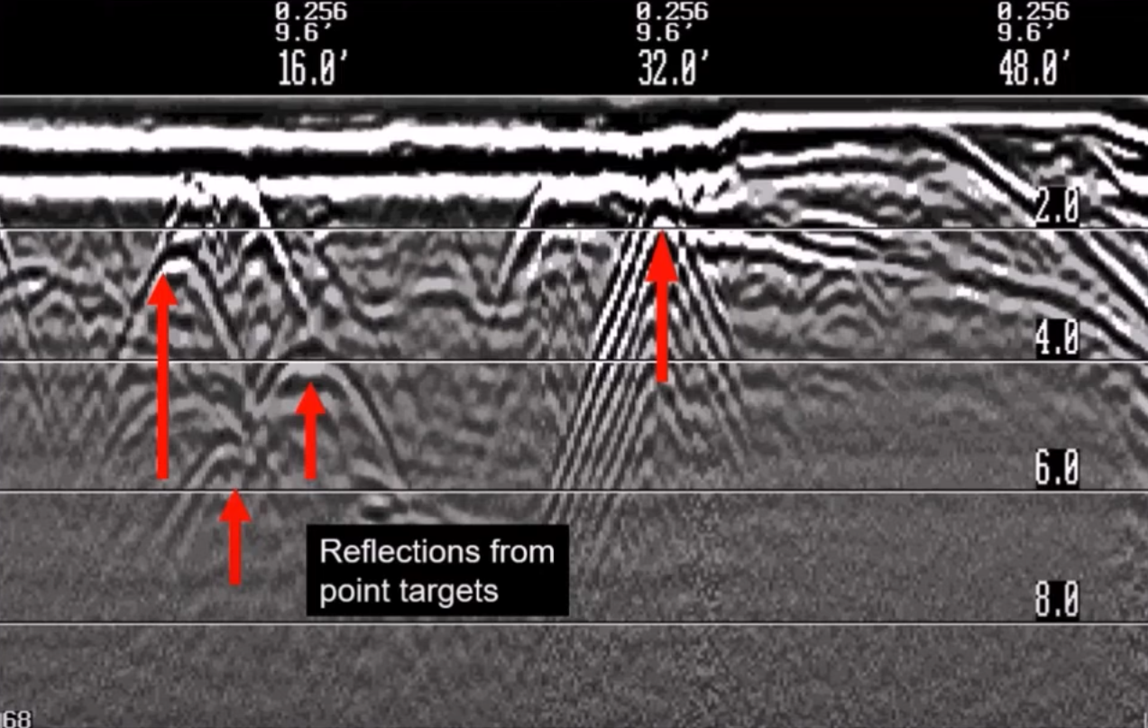
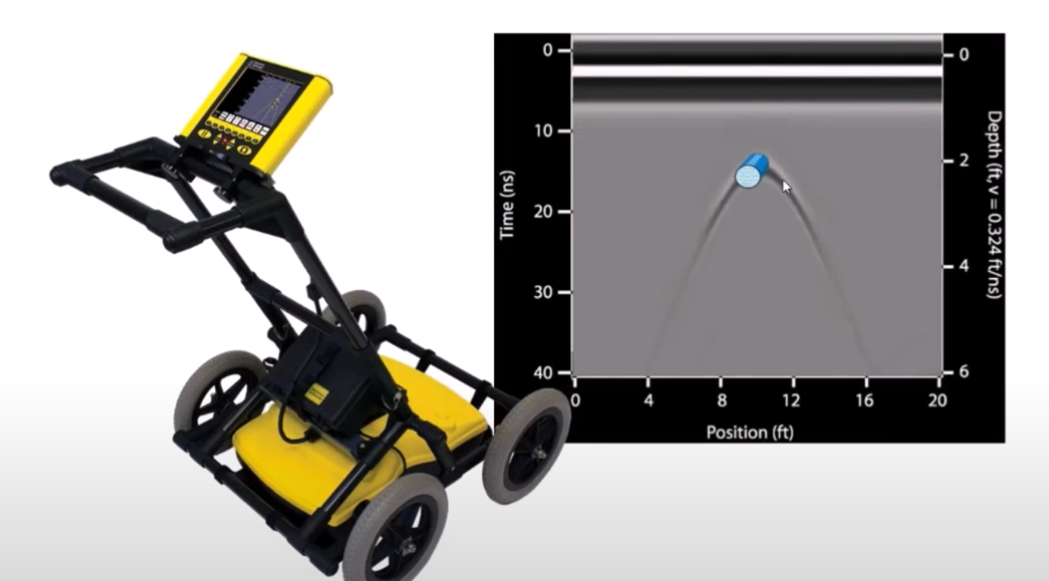
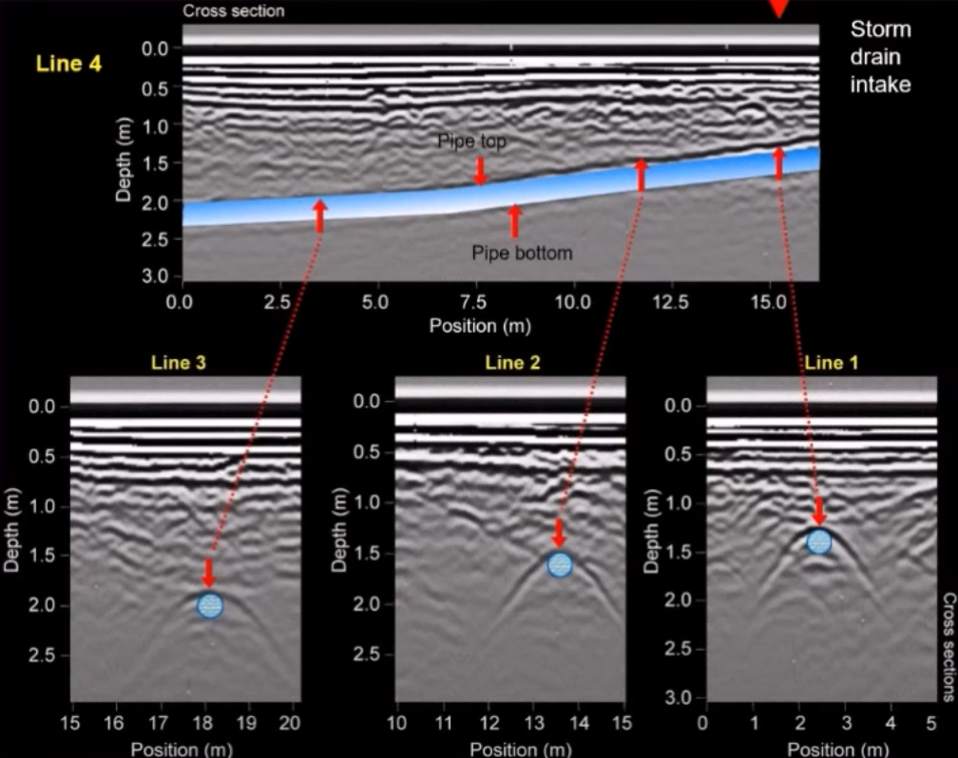
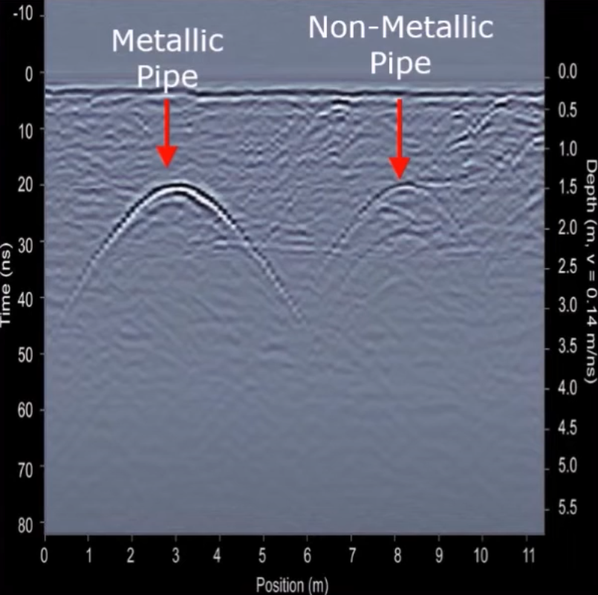
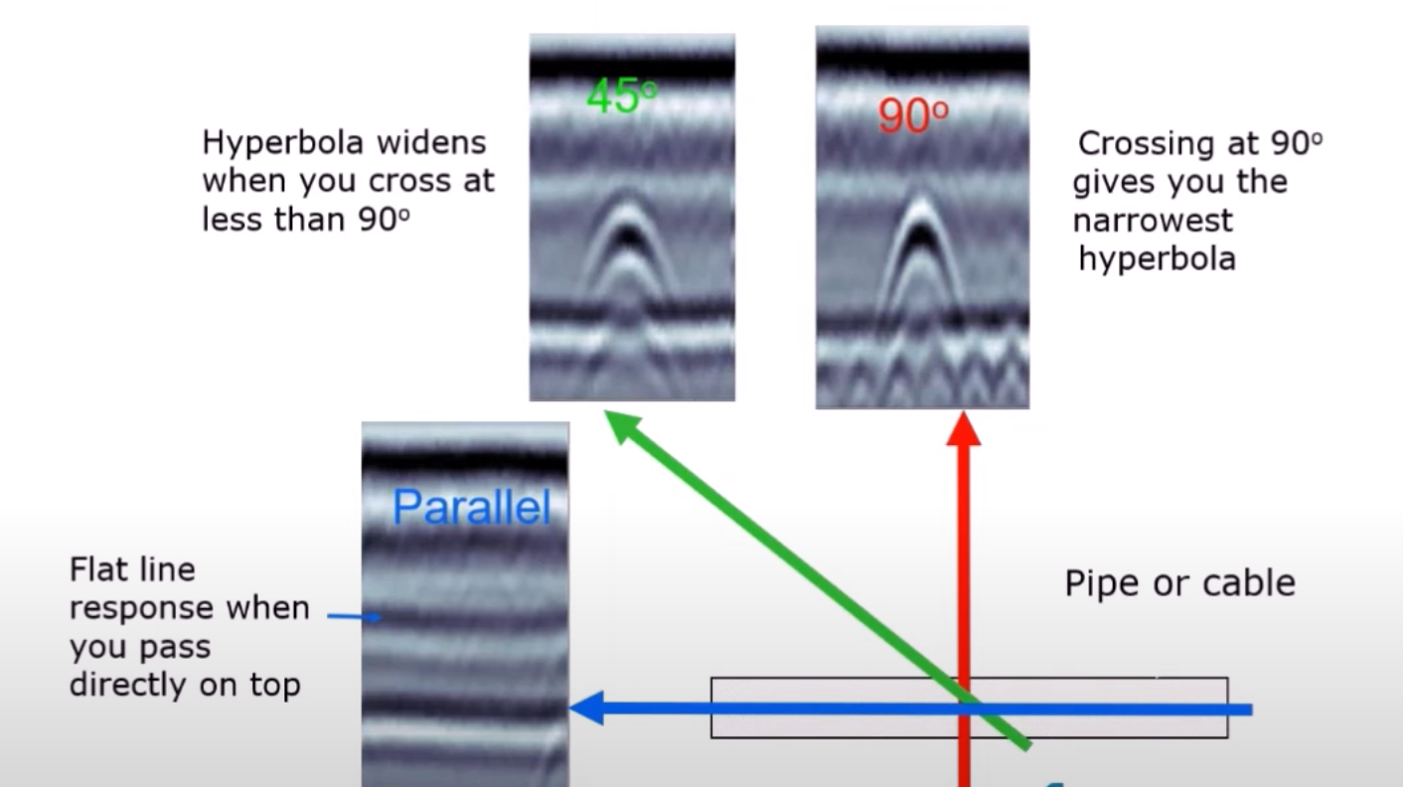
Today → metallic and non metallic pipes
A brief explanation before going to the field
Advanced Geophysical Methods in Natural Resource Investigation
Notes:
Lecture:
The lecture component of this course will provide an overview of advanced geophysical investigation methods used in subsurface exploration. It will cover the principles of magnetometry, geoelectrics, ground-penetrating radar (GPR), and electromagnetic methods, along with an introduction to radiometry and its applications in natural resource exploration. Students will learn about data acquisition techniques for both ground and airborne geophysical surveys, and explore the challenges associated with data interpretation. Additionally, the lecture will address typical workflows used in the processing of geophysical data to ensure accurate results.
Practical training:
The practical training component will focus on providing hands-on experience in fieldwork, utilizing magnetometry, GPR, geoelectric, electromagnetic instruments. Students will actively participate in data acquisition and analysis using specialized software. They will gain experience in processing, and learn how to apply these methods effectively in real exploration scenarios. Practical training will also include the development of field reports and presentations based on data collected during field activities, helping students to refine their skills in communicating technical results

Slide 28
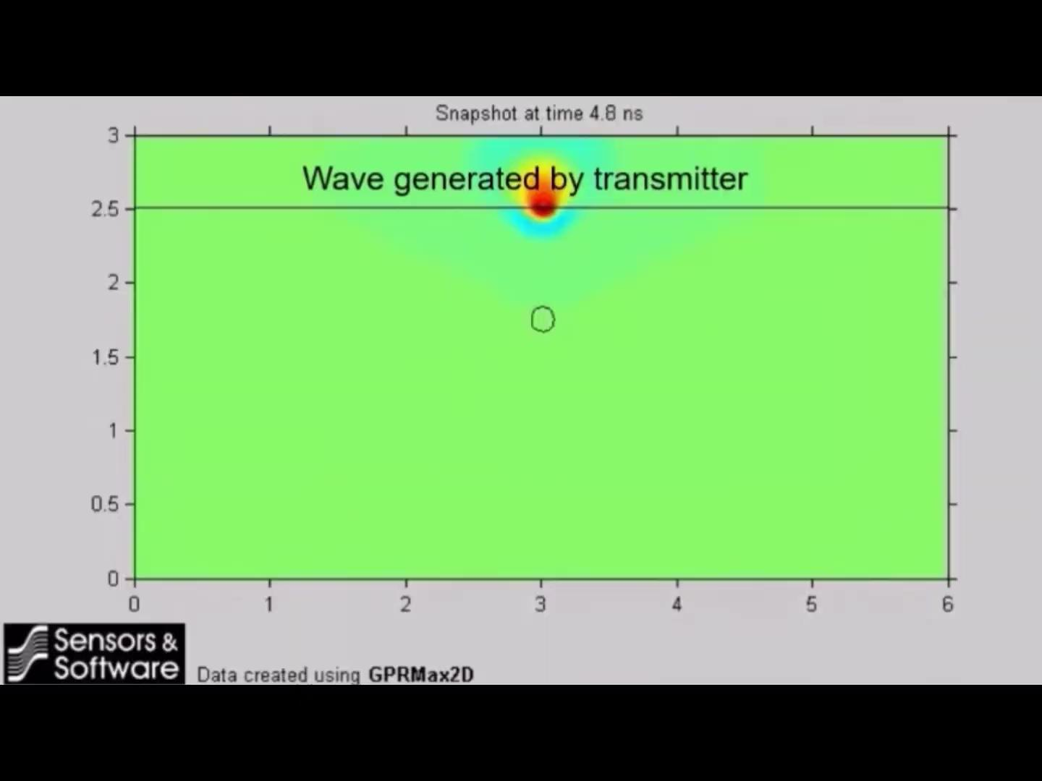
Summary
A brief explanation before going to the field
Computer simulation of GPR signals
Advanced Geophysical Methods in Natural Resource Investigation
Notes:
Lecture:
The lecture component of this course will provide an overview of advanced geophysical investigation methods used in subsurface exploration. It will cover the principles of magnetometry, geoelectrics, ground-penetrating radar (GPR), and electromagnetic methods, along with an introduction to radiometry and its applications in natural resource exploration. Students will learn about data acquisition techniques for both ground and airborne geophysical surveys, and explore the challenges associated with data interpretation. Additionally, the lecture will address typical workflows used in the processing of geophysical data to ensure accurate results.
Practical training:
The practical training component will focus on providing hands-on experience in fieldwork, utilizing magnetometry, GPR, geoelectric, electromagnetic instruments. Students will actively participate in data acquisition and analysis using specialized software. They will gain experience in processing, and learn how to apply these methods effectively in real exploration scenarios. Practical training will also include the development of field reports and presentations based on data collected during field activities, helping students to refine their skills in communicating technical results

Slide 29

Summary
A brief explanation before going to the field
Reflections at boundaries
Advanced Geophysical Methods in Natural Resource Investigation
Notes:
Lecture:
The lecture component of this course will provide an overview of advanced geophysical investigation methods used in subsurface exploration. It will cover the principles of magnetometry, geoelectrics, ground-penetrating radar (GPR), and electromagnetic methods, along with an introduction to radiometry and its applications in natural resource exploration. Students will learn about data acquisition techniques for both ground and airborne geophysical surveys, and explore the challenges associated with data interpretation. Additionally, the lecture will address typical workflows used in the processing of geophysical data to ensure accurate results.
Practical training:
The practical training component will focus on providing hands-on experience in fieldwork, utilizing magnetometry, GPR, geoelectric, electromagnetic instruments. Students will actively participate in data acquisition and analysis using specialized software. They will gain experience in processing, and learn how to apply these methods effectively in real exploration scenarios. Practical training will also include the development of field reports and presentations based on data collected during field activities, helping students to refine their skills in communicating technical results

Slide 30

Summary
A brief explanation before going to the field
GPR is able to detect boundaries between materials with different dielectric permittivity.
→ The greater the contrast, the better the signal reflection.
Electromagnetic waves travel differently depending on the dielectric permittivity of the soil.
→ This difference helps determine the depth of objects using the travel time formula.
Soil conductivity affects signal attenuation.
→ The higher the conductivity, the greater the interaction between the signal and the soil, leading to more energy dissipation. This leading to lower penetration depths.
The frequency of the antenna affects depth and resolution.
→ Low-frequency antennas penetrate deeper but offer lower resolution.
→ High-frequency antennas provide better resolution but have limited penetration depth.
Advanced Geophysical Methods in Natural Resource Investigation
Notes:
Lecture:
The lecture component of this course will provide an overview of advanced geophysical investigation methods used in subsurface exploration. It will cover the principles of magnetometry, geoelectrics, ground-penetrating radar (GPR), and electromagnetic methods, along with an introduction to radiometry and its applications in natural resource exploration. Students will learn about data acquisition techniques for both ground and airborne geophysical surveys, and explore the challenges associated with data interpretation. Additionally, the lecture will address typical workflows used in the processing of geophysical data to ensure accurate results.
Practical training:
The practical training component will focus on providing hands-on experience in fieldwork, utilizing magnetometry, GPR, geoelectric, electromagnetic instruments. Students will actively participate in data acquisition and analysis using specialized software. They will gain experience in processing, and learn how to apply these methods effectively in real exploration scenarios. Practical training will also include the development of field reports and presentations based on data collected during field activities, helping students to refine their skills in communicating technical results

Slide 31
Done! … Time to use the Radar!
A brief explanation before going to the field
Advanced Geophysical Methods in Natural Resource Investigation
Notes:
Lecture:
The lecture component of this course will provide an overview of advanced geophysical investigation methods used in subsurface exploration. It will cover the principles of magnetometry, geoelectrics, ground-penetrating radar (GPR), and electromagnetic methods, along with an introduction to radiometry and its applications in natural resource exploration. Students will learn about data acquisition techniques for both ground and airborne geophysical surveys, and explore the challenges associated with data interpretation. Additionally, the lecture will address typical workflows used in the processing of geophysical data to ensure accurate results.
Practical training:
The practical training component will focus on providing hands-on experience in fieldwork, utilizing magnetometry, GPR, geoelectric, electromagnetic instruments. Students will actively participate in data acquisition and analysis using specialized software. They will gain experience in processing, and learn how to apply these methods effectively in real exploration scenarios. Practical training will also include the development of field reports and presentations based on data collected during field activities, helping students to refine their skills in communicating technical results

Slide 32
Done! … Time to use the Radar!
but before that…
A brief explanation before going to the field
Advanced Geophysical Methods in Natural Resource Investigation
Notes:
Lecture:
The lecture component of this course will provide an overview of advanced geophysical investigation methods used in subsurface exploration. It will cover the principles of magnetometry, geoelectrics, ground-penetrating radar (GPR), and electromagnetic methods, along with an introduction to radiometry and its applications in natural resource exploration. Students will learn about data acquisition techniques for both ground and airborne geophysical surveys, and explore the challenges associated with data interpretation. Additionally, the lecture will address typical workflows used in the processing of geophysical data to ensure accurate results.
Practical training:
The practical training component will focus on providing hands-on experience in fieldwork, utilizing magnetometry, GPR, geoelectric, electromagnetic instruments. Students will actively participate in data acquisition and analysis using specialized software. They will gain experience in processing, and learn how to apply these methods effectively in real exploration scenarios. Practical training will also include the development of field reports and presentations based on data collected during field activities, helping students to refine their skills in communicating technical results

Slide 33
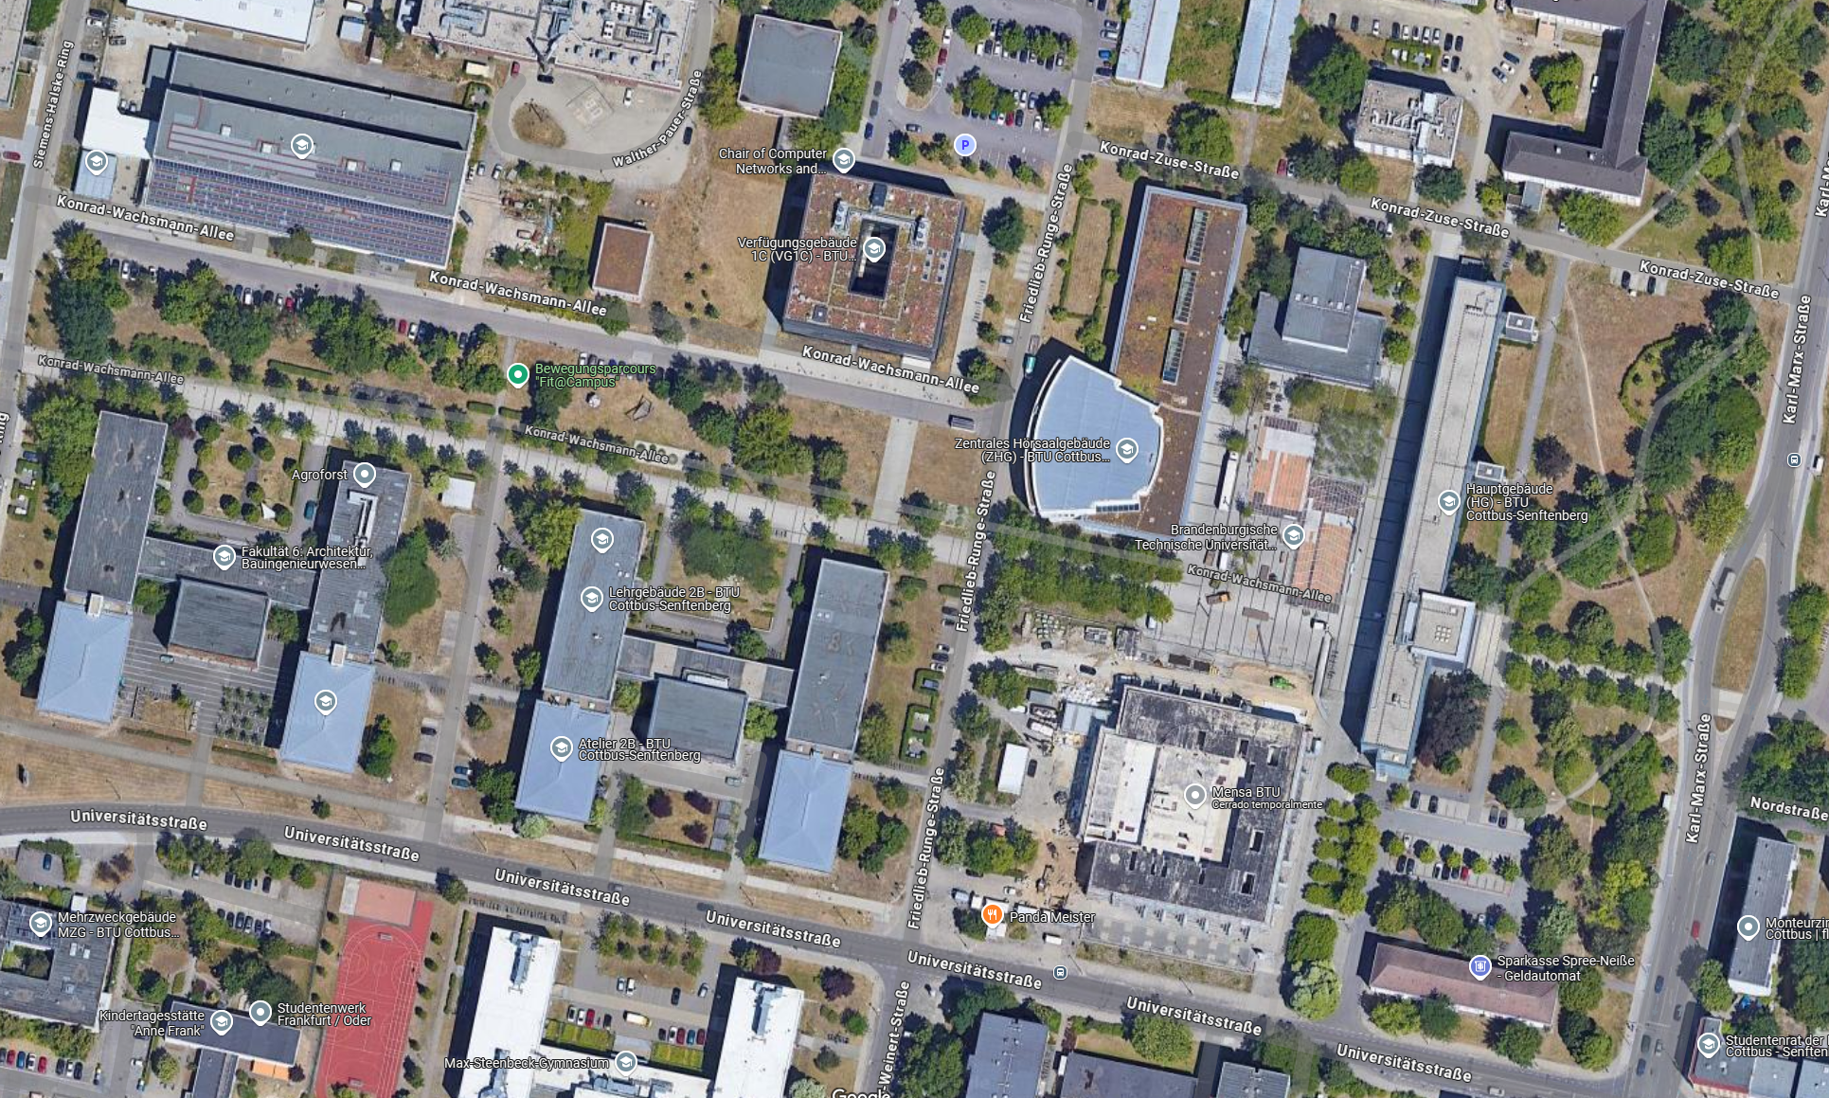
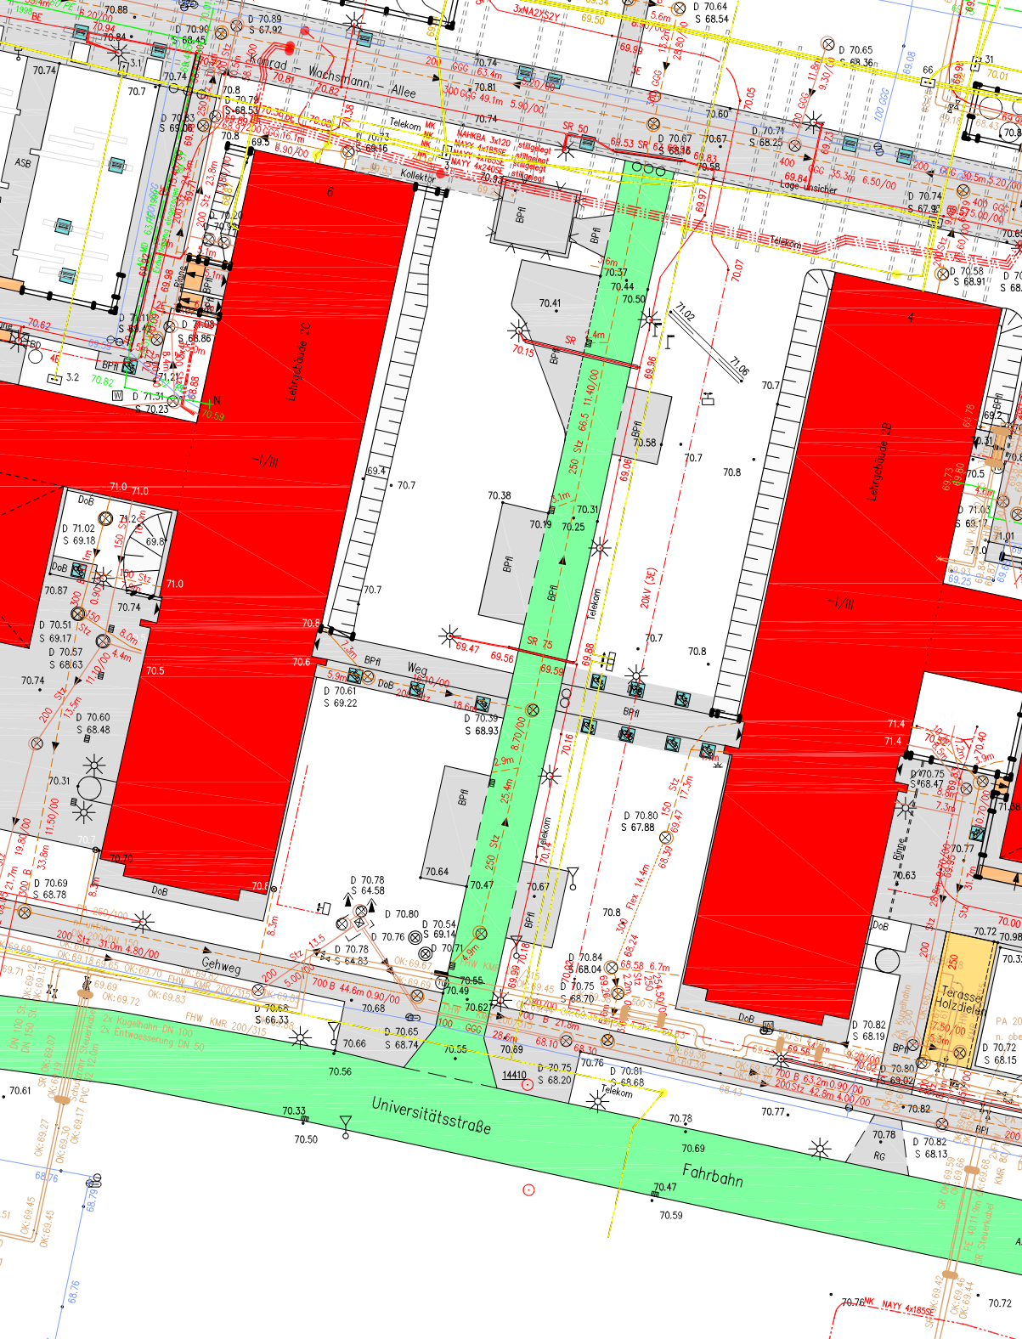
Survey Planning → What are we planning to find?
A brief explanation before going to the field
Utility plan: location of cables, pipes, and similar infrastructure both below and above the ground.
Let's check in we are able to locate utilities like: Storm sewer, Sewer pipe, Power line, Flex line and the differences they show in a radargram
Advanced Geophysical Methods in Natural Resource Investigation
Notes:
Lecture:
The lecture component of this course will provide an overview of advanced geophysical investigation methods used in subsurface exploration. It will cover the principles of magnetometry, geoelectrics, ground-penetrating radar (GPR), and electromagnetic methods, along with an introduction to radiometry and its applications in natural resource exploration. Students will learn about data acquisition techniques for both ground and airborne geophysical surveys, and explore the challenges associated with data interpretation. Additionally, the lecture will address typical workflows used in the processing of geophysical data to ensure accurate results.
Practical training:
The practical training component will focus on providing hands-on experience in fieldwork, utilizing magnetometry, GPR, geoelectric, electromagnetic instruments. Students will actively participate in data acquisition and analysis using specialized software. They will gain experience in processing, and learn how to apply these methods effectively in real exploration scenarios. Practical training will also include the development of field reports and presentations based on data collected during field activities, helping students to refine their skills in communicating technical results

Slide 34
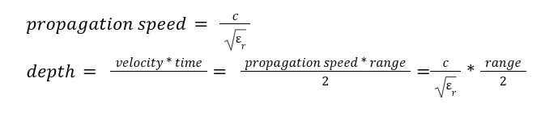
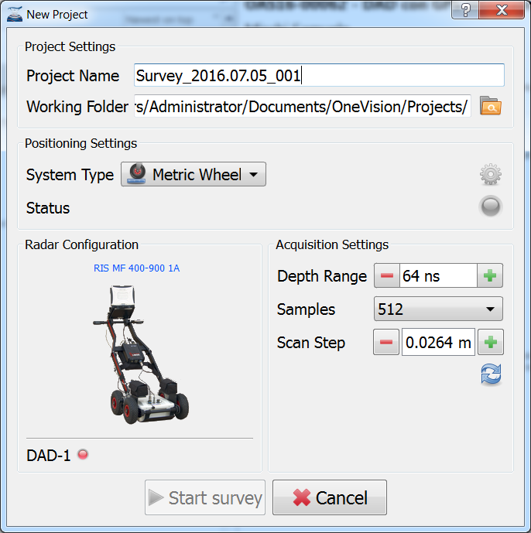
Acquisition software: important parameter setting
A brief explanation before going to the field
Advanced Geophysical Methods in Natural Resource Investigation
Notes:
Lecture:
The lecture component of this course will provide an overview of advanced geophysical investigation methods used in subsurface exploration. It will cover the principles of magnetometry, geoelectrics, ground-penetrating radar (GPR), and electromagnetic methods, along with an introduction to radiometry and its applications in natural resource exploration. Students will learn about data acquisition techniques for both ground and airborne geophysical surveys, and explore the challenges associated with data interpretation. Additionally, the lecture will address typical workflows used in the processing of geophysical data to ensure accurate results.
Practical training:
The practical training component will focus on providing hands-on experience in fieldwork, utilizing magnetometry, GPR, geoelectric, electromagnetic instruments. Students will actively participate in data acquisition and analysis using specialized software. They will gain experience in processing, and learn how to apply these methods effectively in real exploration scenarios. Practical training will also include the development of field reports and presentations based on data collected during field activities, helping students to refine their skills in communicating technical results

Slide 35

Acquisition software: important parameter setting
A brief explanation before going to the field
Advanced Geophysical Methods in Natural Resource Investigation
Notes:
Lecture:
The lecture component of this course will provide an overview of advanced geophysical investigation methods used in subsurface exploration. It will cover the principles of magnetometry, geoelectrics, ground-penetrating radar (GPR), and electromagnetic methods, along with an introduction to radiometry and its applications in natural resource exploration. Students will learn about data acquisition techniques for both ground and airborne geophysical surveys, and explore the challenges associated with data interpretation. Additionally, the lecture will address typical workflows used in the processing of geophysical data to ensure accurate results.
Practical training:
The practical training component will focus on providing hands-on experience in fieldwork, utilizing magnetometry, GPR, geoelectric, electromagnetic instruments. Students will actively participate in data acquisition and analysis using specialized software. They will gain experience in processing, and learn how to apply these methods effectively in real exploration scenarios. Practical training will also include the development of field reports and presentations based on data collected during field activities, helping students to refine their skills in communicating technical results

Slide 36
Acquisition software: important parameter setting
A brief explanation before going to the field
Lateral resolution
Advanced Geophysical Methods in Natural Resource Investigation
Notes:
Lecture:
The lecture component of this course will provide an overview of advanced geophysical investigation methods used in subsurface exploration. It will cover the principles of magnetometry, geoelectrics, ground-penetrating radar (GPR), and electromagnetic methods, along with an introduction to radiometry and its applications in natural resource exploration. Students will learn about data acquisition techniques for both ground and airborne geophysical surveys, and explore the challenges associated with data interpretation. Additionally, the lecture will address typical workflows used in the processing of geophysical data to ensure accurate results.
Practical training:
The practical training component will focus on providing hands-on experience in fieldwork, utilizing magnetometry, GPR, geoelectric, electromagnetic instruments. Students will actively participate in data acquisition and analysis using specialized software. They will gain experience in processing, and learn how to apply these methods effectively in real exploration scenarios. Practical training will also include the development of field reports and presentations based on data collected during field activities, helping students to refine their skills in communicating technical results

Slide 37


Careful! Electromagnetic noise
A brief explanation before going to the field
Advanced Geophysical Methods in Natural Resource Investigation
Notes:
Lecture:
The lecture component of this course will provide an overview of advanced geophysical investigation methods used in subsurface exploration. It will cover the principles of magnetometry, geoelectrics, ground-penetrating radar (GPR), and electromagnetic methods, along with an introduction to radiometry and its applications in natural resource exploration. Students will learn about data acquisition techniques for both ground and airborne geophysical surveys, and explore the challenges associated with data interpretation. Additionally, the lecture will address typical workflows used in the processing of geophysical data to ensure accurate results.
Practical training:
The practical training component will focus on providing hands-on experience in fieldwork, utilizing magnetometry, GPR, geoelectric, electromagnetic instruments. Students will actively participate in data acquisition and analysis using specialized software. They will gain experience in processing, and learn how to apply these methods effectively in real exploration scenarios. Practical training will also include the development of field reports and presentations based on data collected during field activities, helping students to refine their skills in communicating technical results

